Slide 1
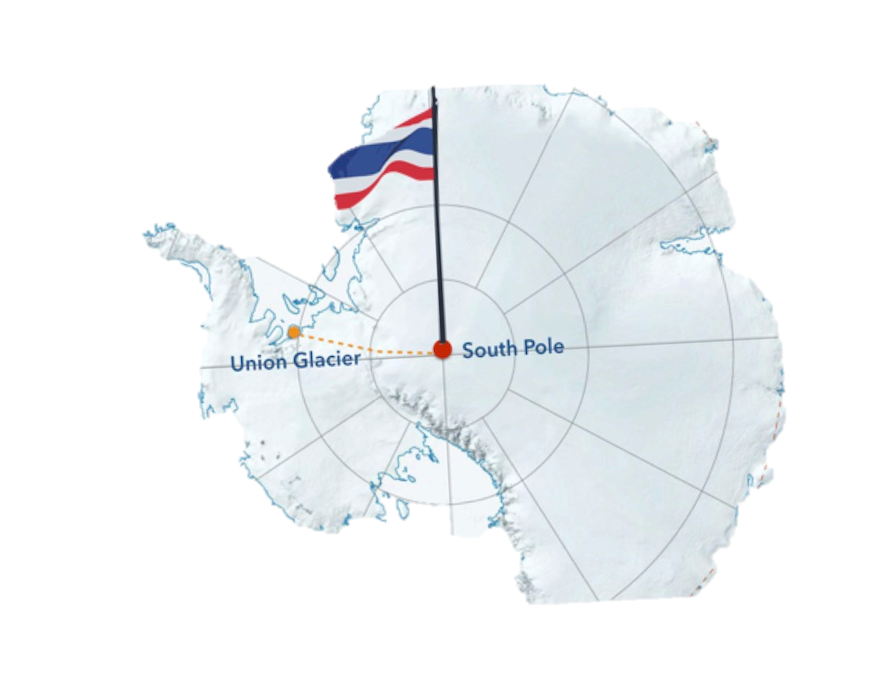
PRESENTATION TO:
Become Part Of History

Slide 2
INTRODUCING
In November 2018, the most ambitious Thai polar expedition of all time will attempt the first ever on foot crossing from the edge of Antarctica to the South Pole – TJ’s TRUE SOUTH.
Opening a new chapter in Thai history with the expeditionary team of ten Thai nationals planting the Thai flag at the South Pole.
The 45-day, 1200 kilometre adventure in temperatures reaching under -50°C is led by Mr. Ake - Thanathorn Juangroongruangkit (TJ).
TJ is seeking nine others to join his group of ten on this great journey.
A route that has only been completed by a mere 19 countries!
The team will camp, eat and live on the ice.

Slide 3
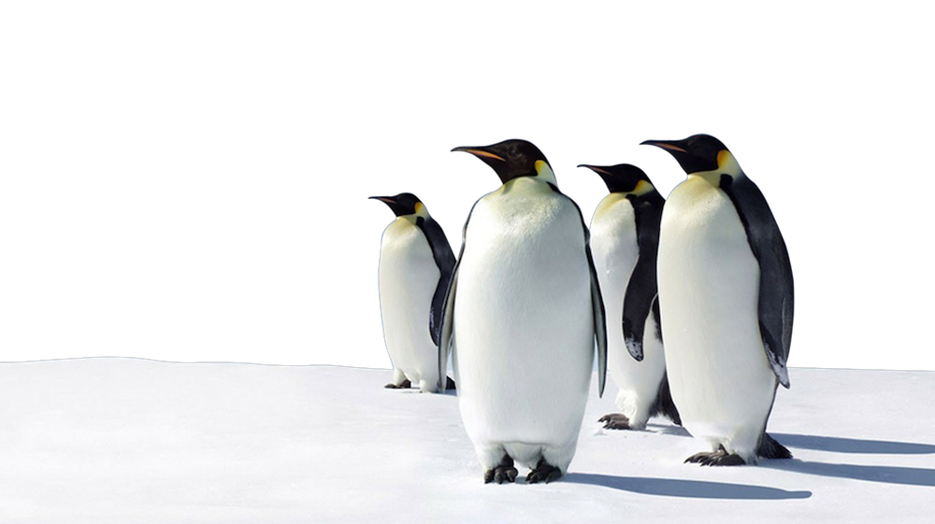
Applications to be part of the team close in March 2017 at www.TrueSouth.org
Applicants will be put through arduous tests & challenges over a 20-month period.
Selection process will be aired on Thai TV.
Nine finalists will be chosen to join TJ – for the
1200 Kilometre, 45-day adventure which will begin
In the last quarter of 2018.
The journey will start from Union Glacier in
Antarctica - the team will reach the South Pole in
January 2019.
Each of the ten team members reaching the South
Pole will receive THB1 Million to donate to the charity
of their choice.
QUICK FACTS

Slide 4
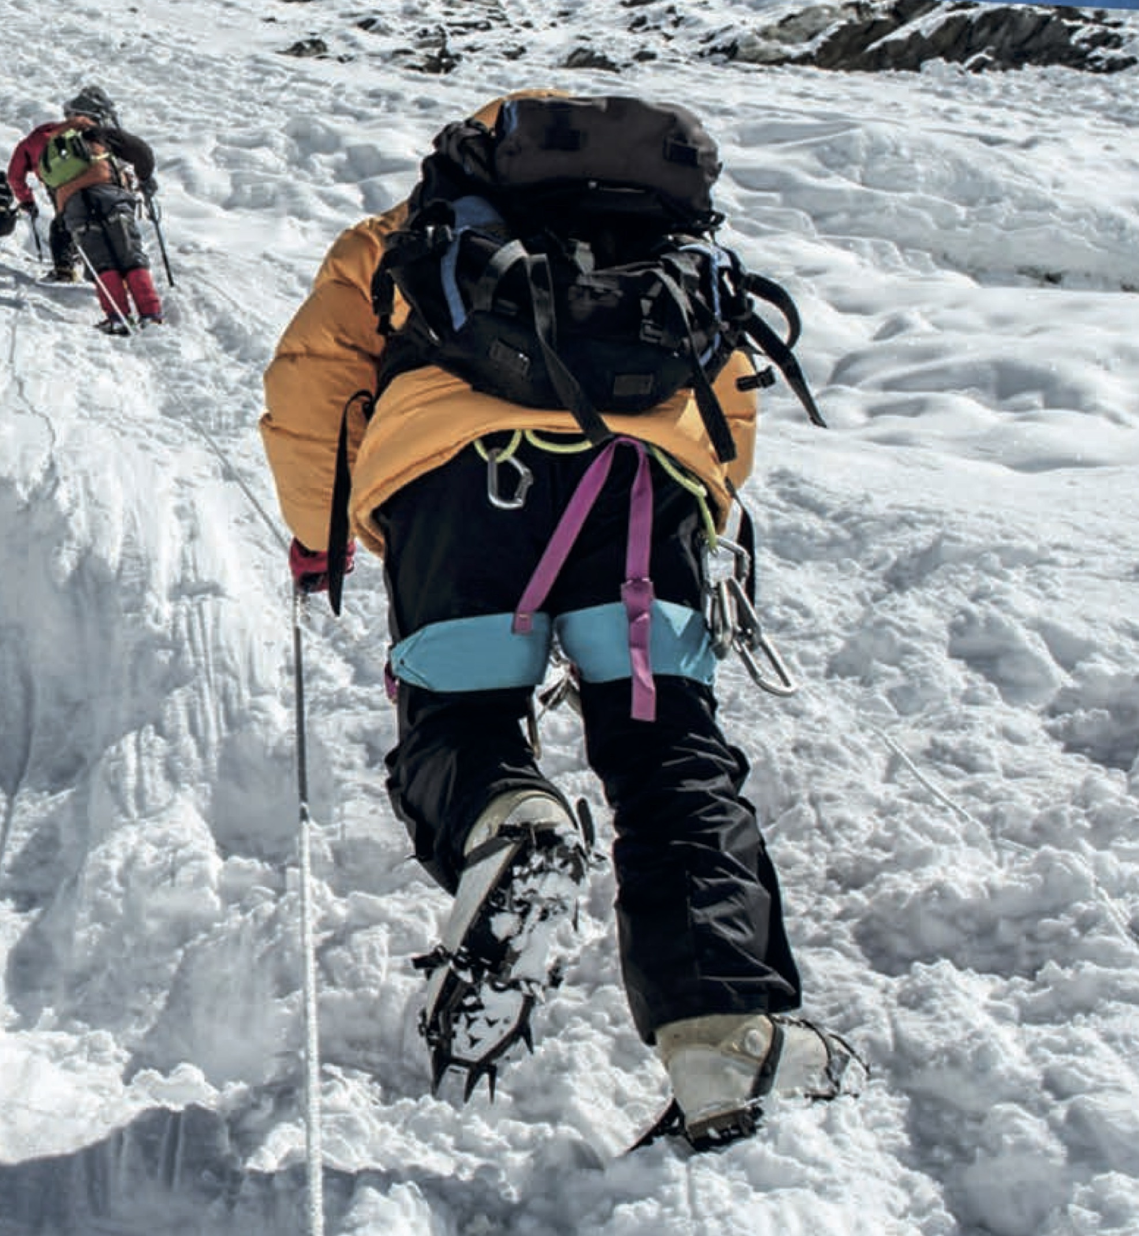
EXPEDITION MISSION
TJ’S TRUE SOUTH will inspire Thai people to achieve their dreams.
The charity Thai Inspire, will invest in people’s dreams & reward those that contribute so people can have a chance to achieve their own.
TJ’S TRUE SOUTH will invest in the future of Thailand, by seeking out those who want to make a difference in the beautiful Kingdom of Thailand.

Slide 5
SPONSORSHIP PACKAGES
TITLE & PRESENTING SPONSORS
One Title Sponsor and one Presenting Sponsor with naming rights to TJ’S TRUE SOUTH
Main branding on expedition promotional literature, athletes and equipment.
CO-SPONSORS – TRUE SOUTH CLUB
Up to six Co-sponsors from non-competing categories. Branding on promotional literature, athletes and equipment and naming rights to an Award for special achievers in areas of:
‘Arts & Culture’ ‘Environmental Conservation’ ‘Rights & Equality’
‘Bravery & Valour’ ‘Innovation & Development’ ‘Social Impact’
OFFICIAL SUPPLIERS
Providing goods & services essential to the success of TJ’s TRUE SOUTH. Major categories include:
Adventure Auto Health & Beauty Medical
Airline Banks & Financial Hotel Mobile Communication
Alcohol Electronics Insurance Technology
Apparel Food & Beverage Logistics Timing
OFFICIAL MEDIA PARTNERS
Up to 10 Official Media Partners providing advertising and editorial support.
CHARITY PARTNERS
TJ’S TRUE SOUTH is also seeking charity partnerships with organisations like: Thai Summit Pattana Foundation; WWF (World Wildlife Fund); and United Nations Thailand.

Slide 6
1200KM CLUB: EXPEDITION SUPPORT TEAM
TJ’S TRUE SOUTH has created a package for both personal supporters - individuals who would like to be an essential part of this history-making event as well as companies and institutions.
Individuals have the opportunity to own 1200 x 1 kilometre sections of this journey.
The 1200KM Club will join an elite group of people who will be part of the Expedition Support Team – they will receive:
1 Kilometre
Rights to title “1200KM Club Member / TJ’S True SOUTH Expedition Support Team” for
PR & advertising use.
Name going into the history books with accreditation in the book 'TJ’S TRUE SOUTH –
Be Part Of Thai History!‘
Official Expedition Support Team Membership with framed Certificate.
Signed Official TJ’S TRUE SOUTH Poster.
10 Kilometres or more
1KM benefits plus
Framed photograph of company branded. flag at the South Pole.
Official Limited Edition TJ’S TRUE SOUTH Jacket.
50 Kilometres or more
10KM benefits plus
Limited Edition TJ’S TRUE SOUTH Watch.

Slide 7
WHY GET INVOLVED?
There are many benefits of an association including:
Be Part Of History
Branding
Athlete Endorsement
Personal Appearances (PAs) & Leadership Training
Hot Ticket Hospitality Events
Networking
Sustainability
CSR
Training Programme
Merchandising
Engagement

Slide 8
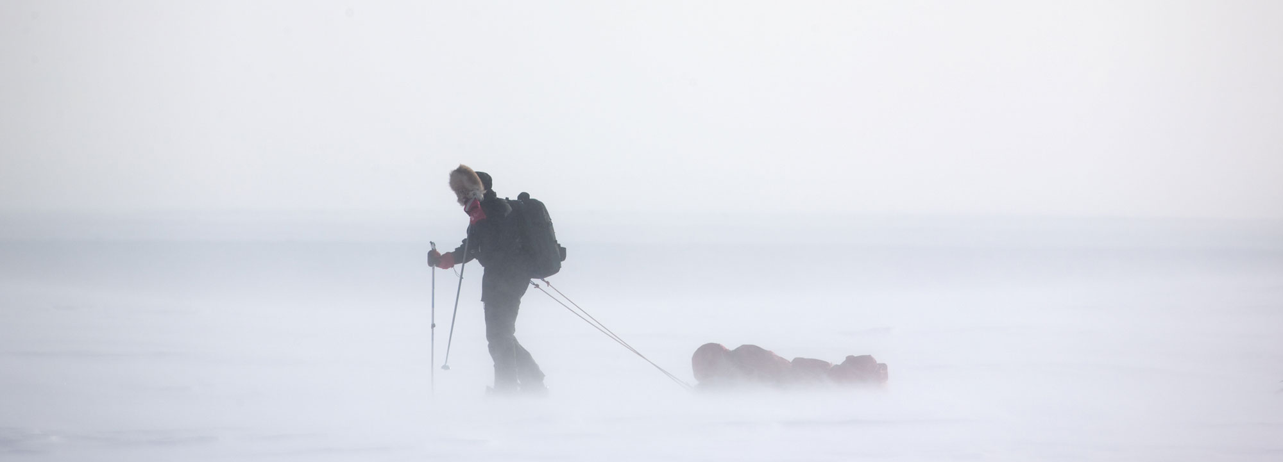
THE LAUNCH
Registration is open from 1st December 2016 to March 2017.
Everyone is encouraged to apply and have the chance to compete in the first Survival Challenge!
TJ says, “We wish to give Thai people the chance to participate in this historical journey, regardless of who they are, what they do or where they come from.”

Slide 9
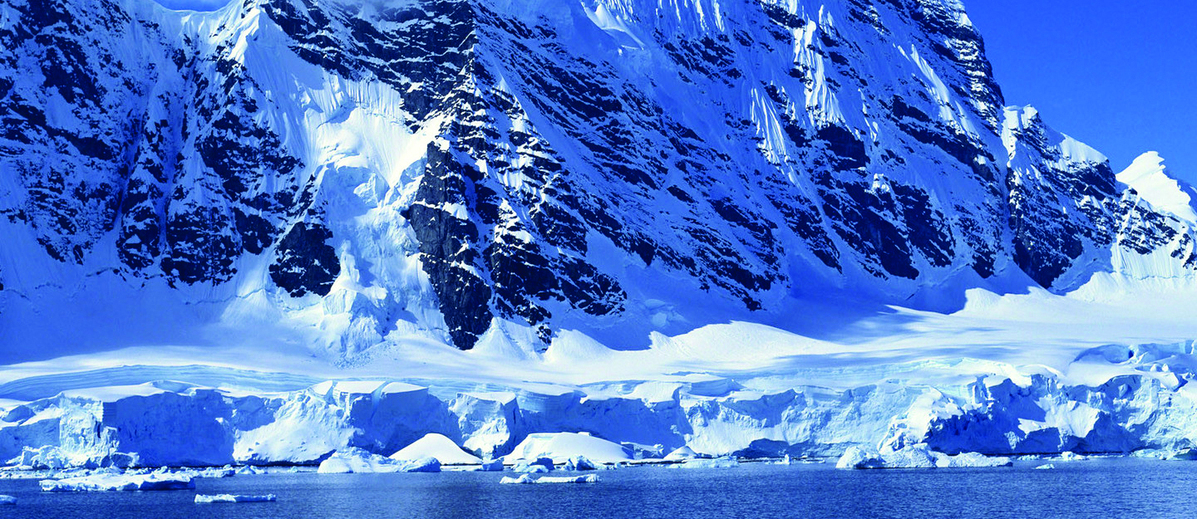
WHO WILL MAKE THE FINAL 10?
Thai public 25-45 yrs Men/Women (+ followers all ages)
Demonstrate high level of fitness
Strive for this incredible opportunity
Have an incredibly strong mind with will power and determination
Adventure & outdoors lifestyle - taking part in serious, extreme adventures
Able to dedicate the time to the training programme & travel for two years
Interested in…
- Sport, Fitness & Recreation
- Extreme Adventure & Exploration
- Health & Wellness
- Environment & Conservation
- Global Travel

Slide 10
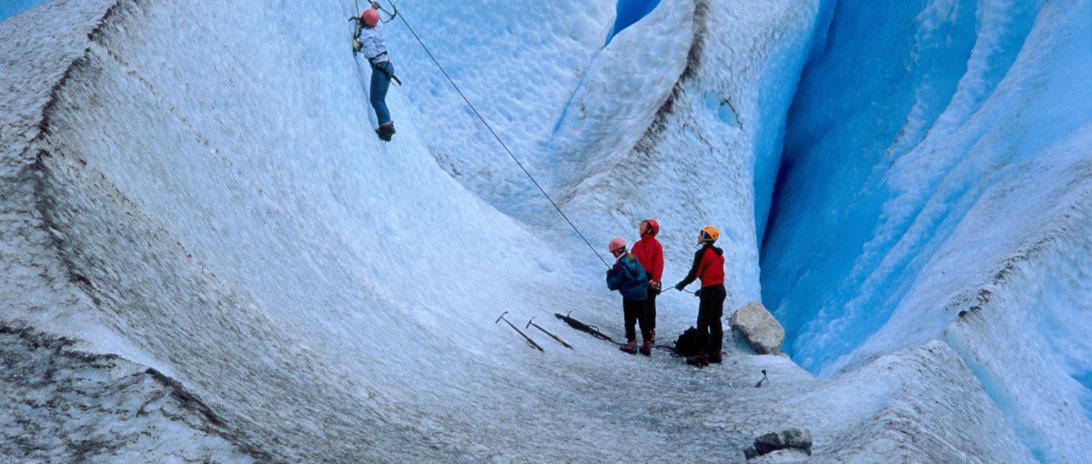
THE CHALLENGES
A series of challenges will need to be overcome to make it to the final team!
The first Survival Challenge, is open for all applicants.
TJ’S TRUE SOUTH contestants will face elimination at each challenge - the experienced adventure selection panel will decide the best for the job!

Slide 11
TRAINING & WORKSHOP SUMMARY
The final 30 applicants will undergo rigorous training intended to push each and every individual outside of their comfort zone.
From learning how to skate on ice, to camping & survival in the wilderness through to international expeditions to some of the most incredible landscapes on our Blue Planet.
The final 15 will then participate in the final training, which will take them around the world including:
Japan - training in the snow, for skiing, camping and hiking.
Nepal Glacier – skills will be tested in one of the world’s most beautiful backdrops.
Canada Skiing - cross country skiing in a long endurance competition.
10 people will remain by the end, with an additional 2 guarantors in case any individual of the final 10 may drop out.

Slide 12
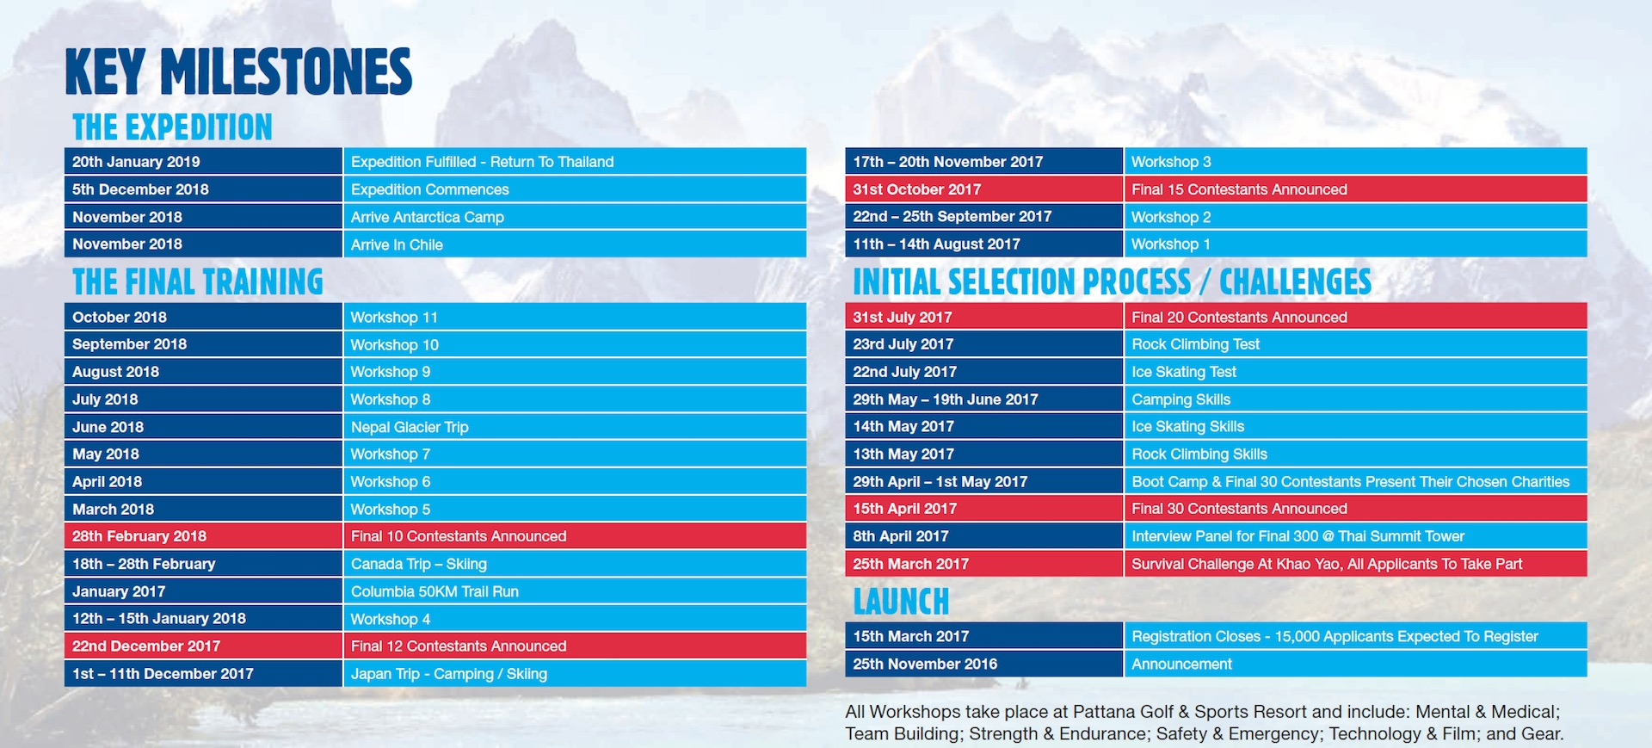

Slide 13
CHARITY & DONATIONS
TJ’S TRUE SOUTH is owned by Thai Summit Pattana Foundation.
Mission is to raise over THB50 Million from the project’s sponsors, other private enterprises and the general public.
Everybody can donate, publicly or privately to reach the minimum target of THB10 Million – THB1 Million for each of the final 10 expedition team to select a charity to donate to.
TJ’S TRUE SOUTH wants to invest in the future of Thailand.
All additional proceeds raised will be distributed at the Thai Summit Pattana Foundation’s discretion.
The Star Programme by Thai Summit Pattana Foundation will benefit from funds raised.
TJ’s SOUTH will hold a number of charity events during the build up to the Expedition including a Launch Gala Dinner in April 2017.

Slide 14
BROADCAST
TV
The selection process for TJ’S TRUE SOUTH will be aired on Thai TV.*
The Initial Selection Process and Final Training will make excellent programming with huge audiences tuning in to watch the Expedition develop and unfold.
SECOND SCREEN
As well as terrestrial and satellite coverage, there are plans to stream content onto second screens in the build-up and during the attempt at the South Pole itself.
The participants will also provide unique footage.
TJ’S TRUE SOUTH will be a huge broadcast opportunity for all partners.
* Currently in negotiations with broadcasters

Slide 15
LICENSING
Title Sponsor and Co-sponsors will be given first right of refusal to produce limited edition TJ’S SOUTH product and merchandise.
For example: TJ’S TRUE SOUTH Beer; TJ’S TRUE SOUTH Watches; TJ’S TRUE SOUTH Whisky.
These opportunities will be managed in line with TJ’S TRUE SOUTH Official Licensing Strategy.

Slide 16
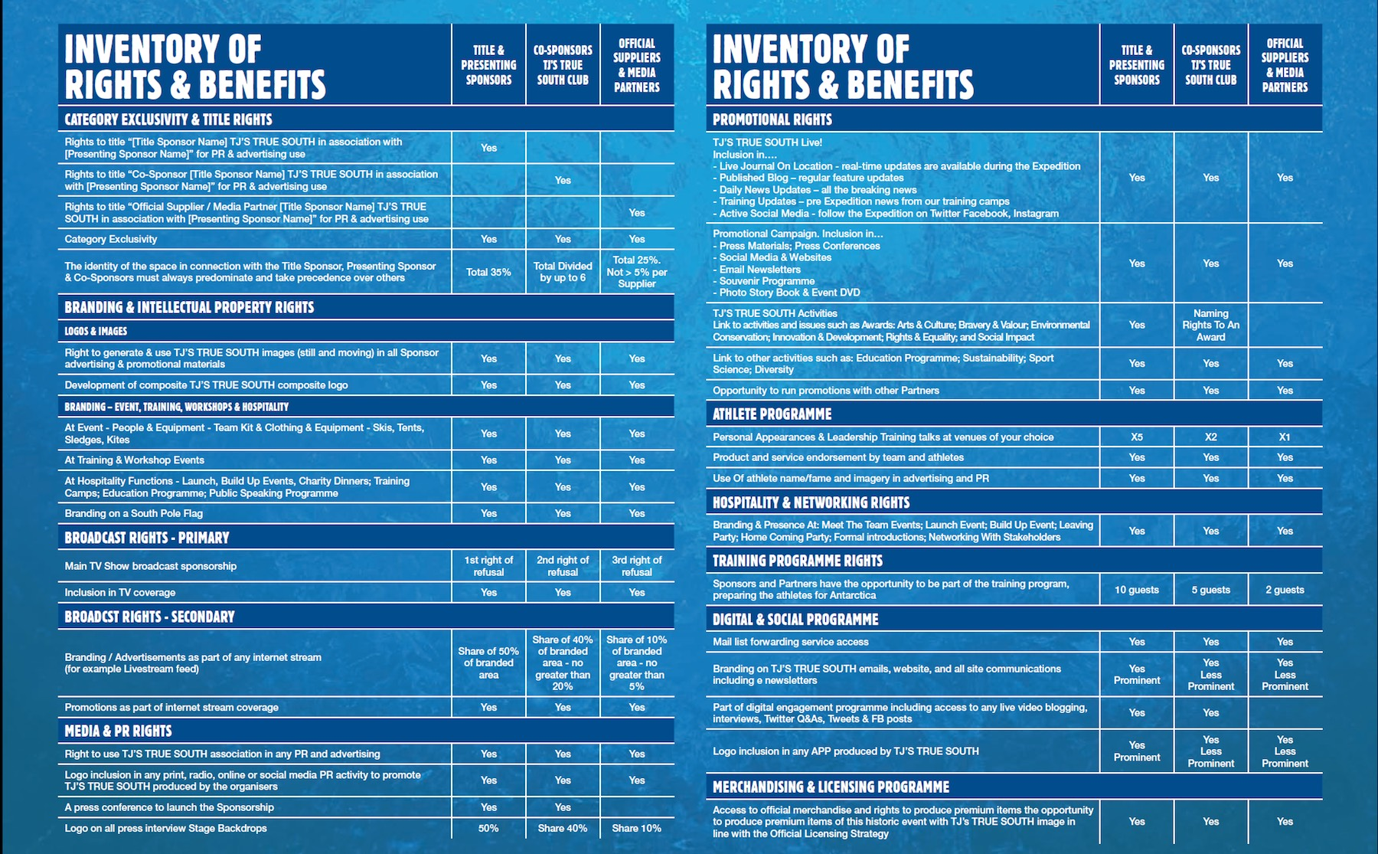

Slide 17
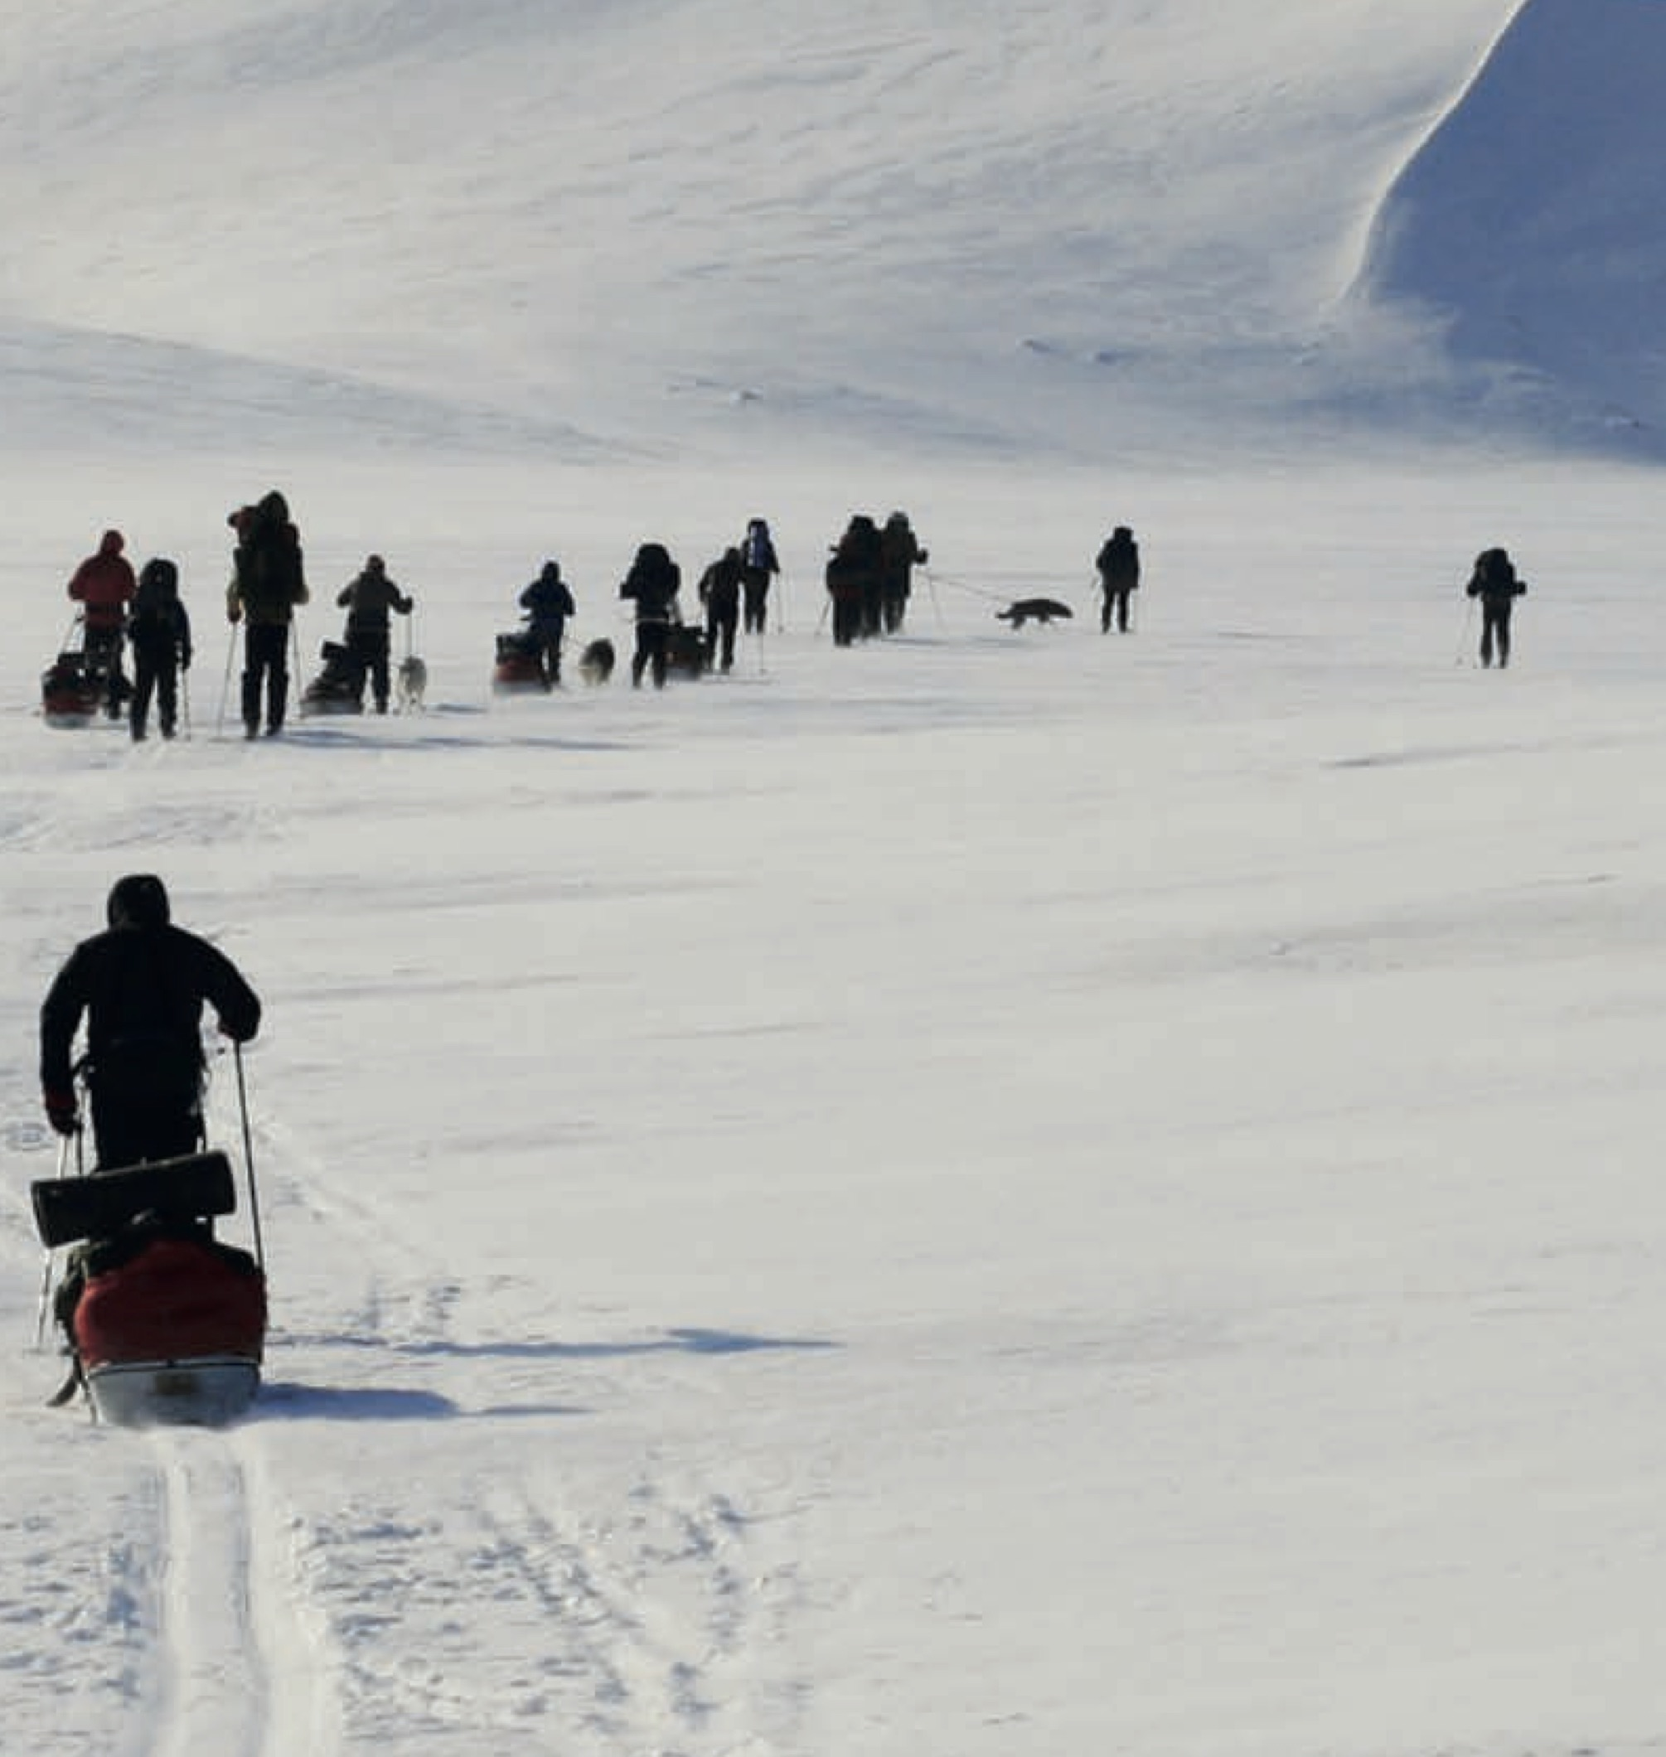
BENEFITS – IN ANTARCTICA
TJ’S TRUE SOUTH LIVE!
Live Journal On Location - real-time updates are available during the Expedition
Published Blog – regular feature updates
Daily News Updates – all the breaking news
Training Updates – pre Expedition news from our training camps
Active Social Media – follow the Expedition on Twitter and Facebook
Expedition Filming - filming before, during & after the event

Slide 18
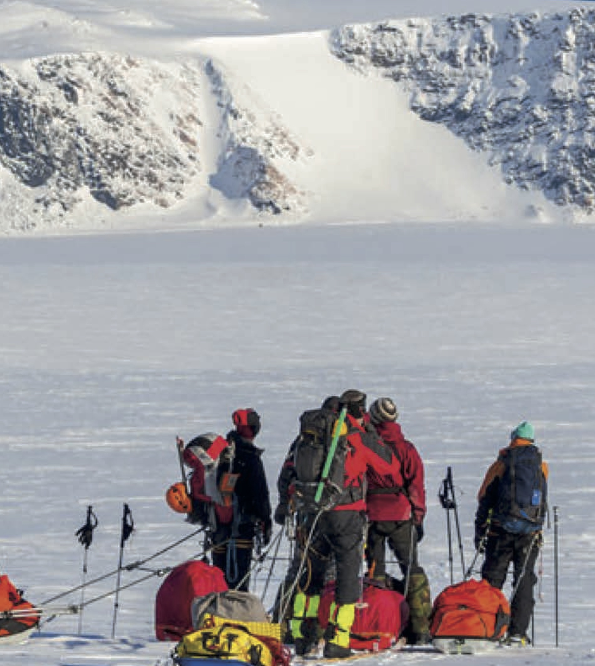
BENEFITS – IN ANTARCTICA
PR & BROADCAST COVERAGE
SOUTH POLE FLAG
TEAM BRANDING
SUSTAINABILITY & CSR
TOPICS RELEVANT TO YOUR BUSINESS – DIVERSITY / SPORTS SCIENCE

Slide 19
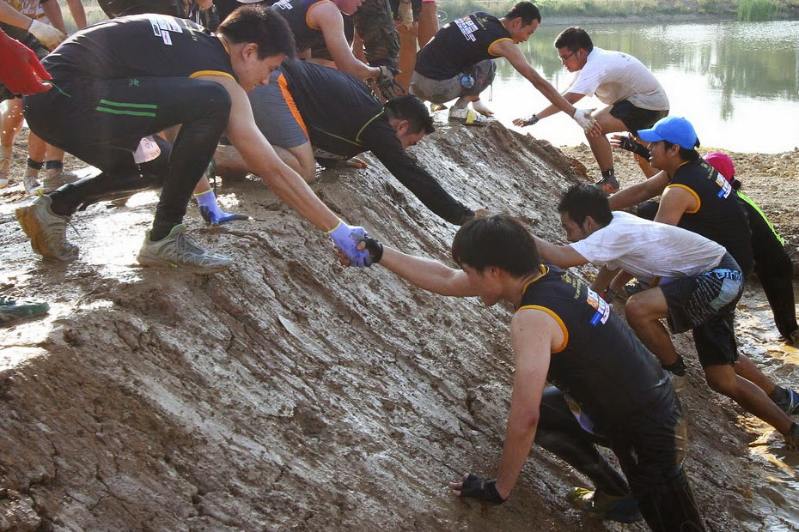
BENEFITS – PRE & POST ANTARCTICA
PROMOTIONAL MATERIALS
SPECIAL EVENTS – HOSPITALITY & NETWORKING
ATHLETE RIGHTS
TJ’S TRUE SOUTH TRAINING
LEADERSHIP & TEAM BUILDING SEMINARS
DATA CAPTURE
EDUCATION PROGRAMME
MERCHANDISING & LICENSING RIGHTS

Slide 20
CONTACT
PAUL POOLE (SOUTH EAST ASIA) CO., LTD.
198 Tanou Road
Bovernives
Pranakorn
Bangkok 10200
Thailand
Tel./Fax: +66 2622 0605 - 7
www.paulpoole.co.th/truesouth
PAUL POOLE
MANAGING DIRECTOR
(ENGLISH SPEAKING)
Email: paul@paulpoole.co.th
Tel. +66 8 6563 3196
UDOMPORN PHANJINDAWAN
PERSONAL ASSISTANT
(THAI/ENGLISH SPEAKING)
Email: udomporn@paulpoole.co.th
Tel. +66 8 6382 9949
TJ’S TRUE SOUTH
4/3 Moo 1 Bangna-Trad HWY
KM.16 Bangchalong
Bangpree District
Samuthprakarn 10540
Thailand
Tel. +66 (0) 9 5982 9615
www.truesouth.org
RATTIGORN NOISIRI
MARKETING MANAGER
Email : Rattigorn.Noisiri@gmail.com
Tel. +66 (0) 9 5982 9615
Facebook - https://www.facebook.com/truesouththailand
Twitter - https://twitter.com/TrueSouthThailand
Instagram - https://www.instagram.com/truesouththailand

Slide 21
APPENDICIES - ABOUT ANTARCTICA
Antarctica is the fifth-largest continent in area - nearly twice the size of Australia. About 98% of Antarctica is covered by ice that averages at least 1.9 kilometres (1.2 mi) in thickness, which extends to all but the northernmost reaches of the Antarctic Peninsula.
Antarctica, on average, is the coldest, driest, and windiest continent, and has the highest average elevation of all the continents. The temperature in Antarctica has reached −89 °C (−129 °F). There are no permanent human residents, but anywhere from 1,000 to 5,000 people reside throughout the year at the research stations scattered across the continent. Only certain animals survive, such as mites, nematodes, penguins, seals and tardigrades.
The Antarctic Treaty was signed in 1959 by 12 countries; to date, 49 countries have signed the treaty, which: prohibits military activities and mineral mining, nuclear explosions and nuclear waste disposal; supports scientific research; and protects the continent's ecozone.
The continent of Antarctica is a very harsh, unforgiving land – covered in ice and at the southern most tip of the world very little life can survive in the sub zero temperatures, but surprisingly so there are still many arctic species found inhabiting it’s surrounds.
After it’s known discovery in the late 1700’s and early 1800’s – the Heroic Age of Antarctic Exploration began at the end of the 19th century and closed with Ernest Shackleton's Imperial Trans-Antarctic Expedition in 1917.

Slide 22
APPENDICIES - ABOUT ANTARCTICA
The history of Antarctica emerges from early Western theories of a vast continent, known as Terra Australis, believed to exist in the far south of the globe. The term Antarctic, referring to the opposite of the Arctic Circle, was coined by Marinus of Tyre in the 2nd century AD.
Several expeditions attempted to reach the South Pole in the early 20th century, during the 'Heroic Age of Antarctic Exploration'.
The first successful trip to the South Pole was by Norwegian Roald Amundsen and his party on December 14, 1911. However, unaware of this trip, the British party of Robert Falcon Scott & 4 men reached the South Pole on January 17, 1912, thirty-four days after Amundsen - however all sadly died on the return trip.
The next successful trip was by New Zealander Edmund Hillary (January 4, 1958) and Vivian Fuchs (January 19, 1958) and their respective parties, during the Commonwealth Trans-Antarctic Expedition.

Slide 23
APPENDICIES - ABOUT ANTARCTICA
SHORT FACTS
The 19 countries which have successfully reached the South Pole on foot include: Australia, Canada, Denmark, Finland, France, Germany, Lebanon, New Zealand, Norway, Poland, Russia, South Africa, South Korea, Spain, Sweden, Switzerland, UK and USA.
Expected December temperatures - average high -26.5ºC / Average low -29.3ºC.
No native flora or fauna occur naturally in Antarctica.
There have been 118 of 123 successful unsupported attempts.
22 of these attempts were solo, with the last completed in 13/01/2015.
13 successful unsupported North & South Pole attempts.
The fastest South Pole attempt on foot was 23 days 5 hours.
ATTEMPTS TO THE SOUTH POLE IN RECENT YEARS
2006 - Christian Eide, Norwegian holds the fastest unsupported trip of 24 days from near ‘Hercules Inlet’.
2012 - Norwegian Aleksander Gamme (solo) and Australians James Castrission and Justin Jones achieved the first unsupported trip and back.
2013 - Maria Leijerstam completed the first tricycle ride from coast to South Pole.
2014 - Daniel P. Burton completed the first bicycle ride from coast to the South Pole.
2016 - British Henry Worsley died while attempting to complete the 70 day first solo and unaided crossing of the Antarctic.

Slide 24
APPENDICIES - ABOUT TJ
Mr. Thanathorn Juangroongruangkit is Executive Vice President of Thai Summit Group and founder of ‘TJ’S TRUE SOUTH.
TJ loves outdoor active lifestyle. He runs ultra marathons, kayaks open water, dives with his advance PADI degree, skis and snowboards, rock climbs, hikes and mountaineers peaks and trails around the world.
He ran 250KM across the Gobi and Sahara deserts and was the first Asian to complete the 560KM self-supported foot race above the Arctic Circle as well as kayaking along the Ping and Chaopraya rivers for 600KM from Chiang Mai to Signburi!

