Slide 1
THAILAND
YACHT SHOW
2018
AO PO GRAND MARINA , PHUKET

Slide 2
INTRODUCING
The third edition of the Thailand Yacht Show returns to Ao Po Grand Marina, Phuket between 22 - 25 February 2018
Expected to attract some 5,000 visitors and over 100 exhibitors - shining the spotlight on Phuket as one of the Asia’s premier cruising destinations
Bringing together industry and consumers alike in a relaxed environment with a programme packed with seminars, social events, demonstrations, regattas and familiarisation excursions
Exhibitors include: the best in yachting and boating; and luxury products and lifestyle brands, including supercars, watches and jewelry as well as luxury waterside properties
2018 will be bigger and better with more sea-trials and equipment demonstrations in the marina, together with various ancillary events running alongside, turning the Show into a major festival of yachting and boating that is not to be missed!

Slide 3
INTRODUCING
The Show is at the beginning of the international winter charter season and attracts the Mediterranean based charter yachts considering a visit to Asia, as well as the all important Ultra High Net Worth Individuals (UHNWIs) and High Net Worth Individuals (HNWIs) visitors from around the region who want to come and try out the lifestyle
The event is supported by the Thai government and is a partnership with the Ministry of Tourism, the Tourism Authority of Thailand, and the Marine Department of the Ministry of Transport
Organised by Verventia Pte. Ltd.

Slide 4
2016 SHOW FACTS & FIGURES

Slide 5
SPONSORSHIP PACKAGES
TIER 1: TITLE & PRESENTING SPONSORS
One title and one presenting sponsor with naming rights to the event
TIER 2: CO-SPONSORS
Up to six co-sponsors from non-competing categories
TIER 3: LOCAL PARTNERS & MARINE INDUSTRY SUPPORTERS
Packages for Phuket & marine industry businesses
EXHIBITION ONLY PACKAGES
Packages to exhibit at the Thailand Yacht Show 2018

Slide 6
WHO SHOULD SPONSOR?
The Thailand Yacht Show 2018 is a great opportunity for brands in the following sectors:
Airlines, luxury travel, hotels, golf
Exotic cars, motorbikes
Fashion and cosmetics
Fine wine, whisky and other spirits, cigars
Luxury property and resorts
Luxury watches and jewelry
Private banks and financial services
Up-market collectables
Yachts and boats, private aviation

Slide 7
WHY GET INVOLVED?
Sponsorship packages are designed to provide an exceptional combination of networking and corporate branding opportunities, including:
• new client acquisition
• worldwide publicity through a global marketing campaign
• access to a highly exclusive UHNWI/HNWI network
• promoting sponsors as industry leaders
• enhancing corporate image and brand exposure
• adding value to a brand’s marketing campaign
• generating direct access to target markets
A perfect opportunity to:
• boost profile among influential decision makers
• strengthen global awareness of products and services
• meet UHNWIs & HNWIs
• align a brand with an exceptional & exclusive global event

Slide 8
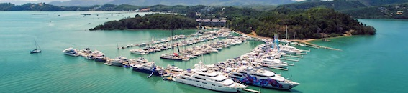
LOCATION - PHUKET
Phuket is strategically located for yachts coming from the Mediterranean to visit South East Asia and the Pacific beyond. It is considered the main infrastructural ‘hub’ for large yachts cruising the region, with over 100 superyacht berths available between the Ao Po Grand Marina and Phuket Yacht Haven
Phuket is unquestionably the destination hub for large yachts in Asia. Nowhere else is there such a large capacity to berth them
In recent years, Phuket has played host to world-leading yachts M/Y A, M/Y Octopus, M/Y VaVa II, M/Y Cloud 9, S/Y Vertigo, S/Y Twizzle, M/Y Exuma, M/Y La Familia and many more
www.phuket.com

Slide 9
FACILITIES & EVENTS
ON-WATER SUPERYACHT SHOW
Some of the exhibiting superyachts will be available for sea trials, enabling potential buyers to get a feel for the boat and the lifestyle
DOCKSIDE MARINE VILLAGE
Yacht builders, brokers and designers will join key industry suppliers of engines, electronic equipment, interiors and specialised refit and repair services in the dockside village
SUPERYACHTS
Superyachts represent the pinnacle of the luxury market, through which UHNWIs confirm their success and demonstrate their taste for the high life
LUXURY BRANDS
A dedicated luxury brand section with some of the most exclusive brands in: watches, jewelry, supercars and private jets will be on display
SOCIAL PROGRAMME
During the four days of the Show the docks are abuzz with a mixture of dock parties, events within the floating VIP Lounge, and exclusive parties onboard some of the biggest and most luxurious yachts at the event

Slide 10
SPONSORS – 2016 SHOW

Slide 11
PARTICIPANTS 2016
VISITORS BY GEOGRAPHY
The Thailand Yacht Show welcomes some of the world’s leading names in yacht charter, boat sales, luxury lifestyle products and marine accessories. Designed to attract new potential buyers, experienced boaters and people in the business alike, a smorgasbord of entrepreneurs and major corporations supported the first edition of the event as exhibiting partners
Over 65 brands were on display, from equipment suppliers and charter brokers to resorts and complementary luxury lifestyle brands. The 2,800-odd HNWI and UHNWI visitors had plenty to keep them interested and entertained
On the water and in the exhibitor’s tent, a mixture of the world’s leading international brokerage houses and well established local dealers used the event to showcase some of their most impressive and exciting yachts and boats available for sale and charter in the region. Asia Marine, Azimut Yachts, Boat Lagoon Yachting, Burgess, Lee Marine, Northrop & Johnson Asia and Simpson Marine all supported the Show by bringing a very respectable fleet of vessels on display
Other brands that exhibited at the Show included the Thai silk company, Jim Thompson; the yacht chandlery company, East Marine; luxury residential resort, MontAzure; and contemporary furniture distributor, Quattro. A wide range of other complementary yachting brands also took part over the four-day event, from hosting evening parties to sponsoring the Thailand Yachting Forum
EXHIBITORS BY GEOGRAPHY

Slide 12
EXHIBITORS 2016
Airship Rib
Andaman Cruises
Asia Marine
Awlgrip & International Paint
Azimut Yachts Thailand
Baba Beach Club by Sri Panwa
Bake Kajonkiet
Banyan Tree Resort
Blu Inc Media
Boat Lagoon Yachting Co., Ltd
BVZ Asia
Delta Properties
DWP | BUZZ
EA Mechanics Co., Ltd
East Marine
Farnova Yachts
Galileo
Harcourt Yachting Crew Management
Hong Seh
Illuzion
Italthai Marine Limited
Java Yachting
Kajonklet International School (KIS)
Kenkoon
Lee Marine
Leopard Catamarans
Livart Marine
Luxberths
Markagain
Mineral Pool Systems
MontAzure
Multihull Solutions Asia
Ocean Emerald
Ocean Yacht Marina
Phuket Gazette
Phuket Marina Engineering
Phuket Old Town
Poe Ma Insurance
Port Takola Yacht Marina
Pure Latex
RL Magazine
Sansiri
Simpson Marine (Thailand) Limited
Sunbrella
TMBA Lounge
Twin Palms

Slide 13
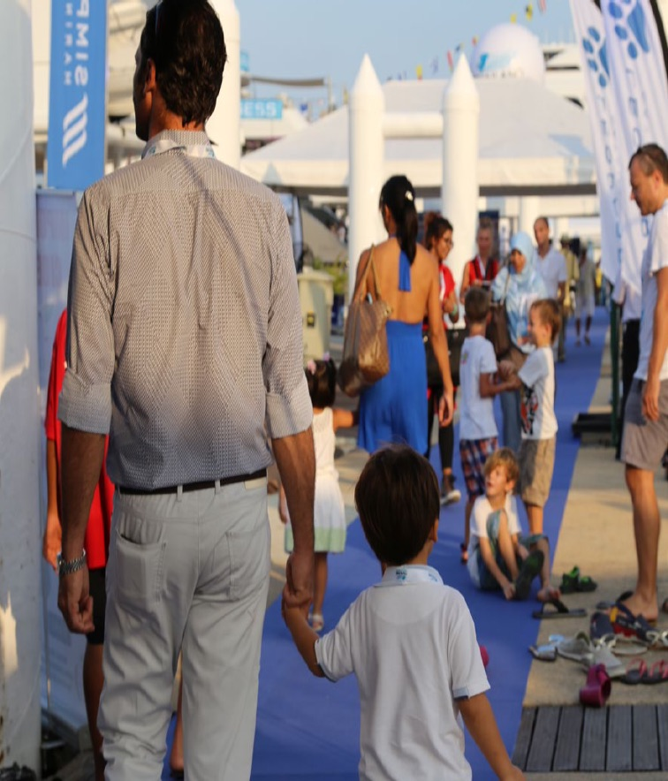
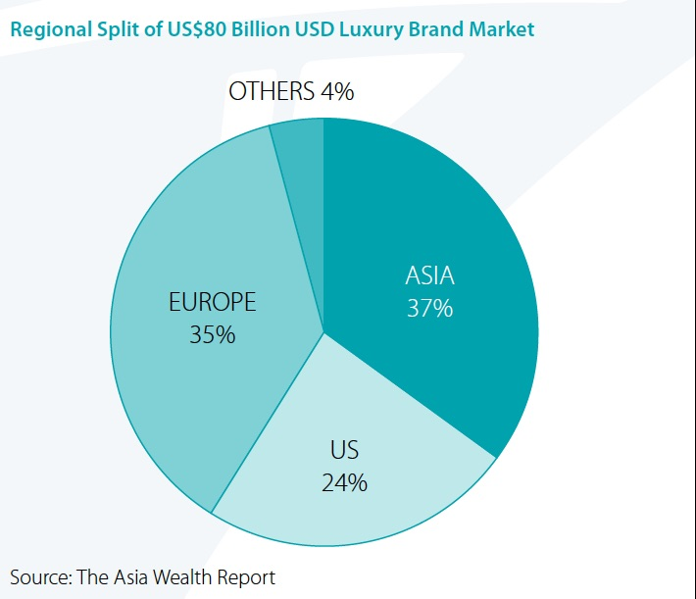
ULTRA HIGH NET
WORTH INDIVIDUALS
LUXURY GOODS
MARKET IN ASIA
The story of the next decade in wealth will most definitely include Indonesia, Thailand, Malaysia and the Philippines – all are populous, have considerable inward investment, and are improving infrastructure
By 2040, Asia will be home to more than 165,000 UHNWIs
‘Decade of Wealth’, Wealth-X, 2015.
Asia is the world’s largest and fastest growing market for the consumption of luxury products
The global luxury brand market is approximately US$80 billion, of which Asia has the largest market share at 37%, followed by Europe at 35%, the US 24%, and the rest of the world at 4%

Slide 15
ISLAND PARTNER & MARINE INDUSTRY SUPPORTER PACKAGES
ISLAND PARTNERSHIP
• Use the event’s name / logo in your own publicity
(e.g. “Official Island Partner of...”)
• Logo / hotlink on event website sponsors’ page
• Logo + 1⁄4 page advertisement in event programme
• Logo on event poster / billboards (Island coverage)
• 5 x VIP passes
• Promotional literature at event
• Logo on stage / interview area backdrop(s)
MARINE INDUSTRY SUPPORTERS
• Use the event’s name / logo in your own publicity
(e.g. “Official Supporter of...”)
• Company name / Hotlink on event website sponsors’ page
• Logo in event programme sponsors’ page
• Company name on event poster / billboards (Island coverage)
• Company name in media partner advertising
• 2 x VIP Passes
• Promotional literature at event
• Logo on stage / interview area backdrop(s)

Slide 16
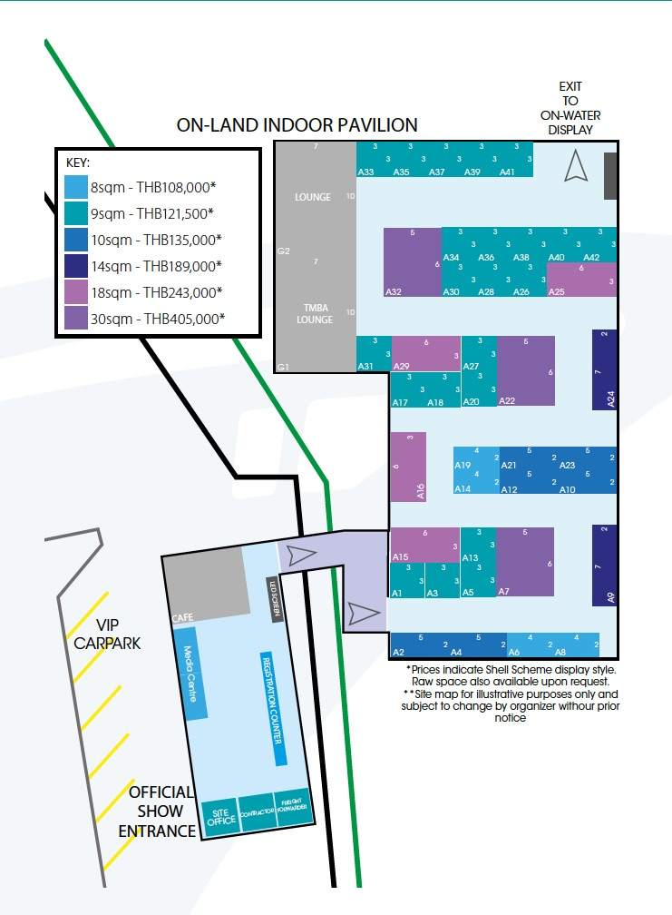
EXHIBITOR OPTIONS
Participating in the Thailand Yacht Show 2018 is the best opportunity to gain access to the fast growing yachting and cruising industry in South East Asia and beyond
Booking is now open for exhibitors; please refer to the 2018 Plans on the right
Early booking is recommended to secure your preferred spot
PAVILION LAYOUT MAP

Slide 17
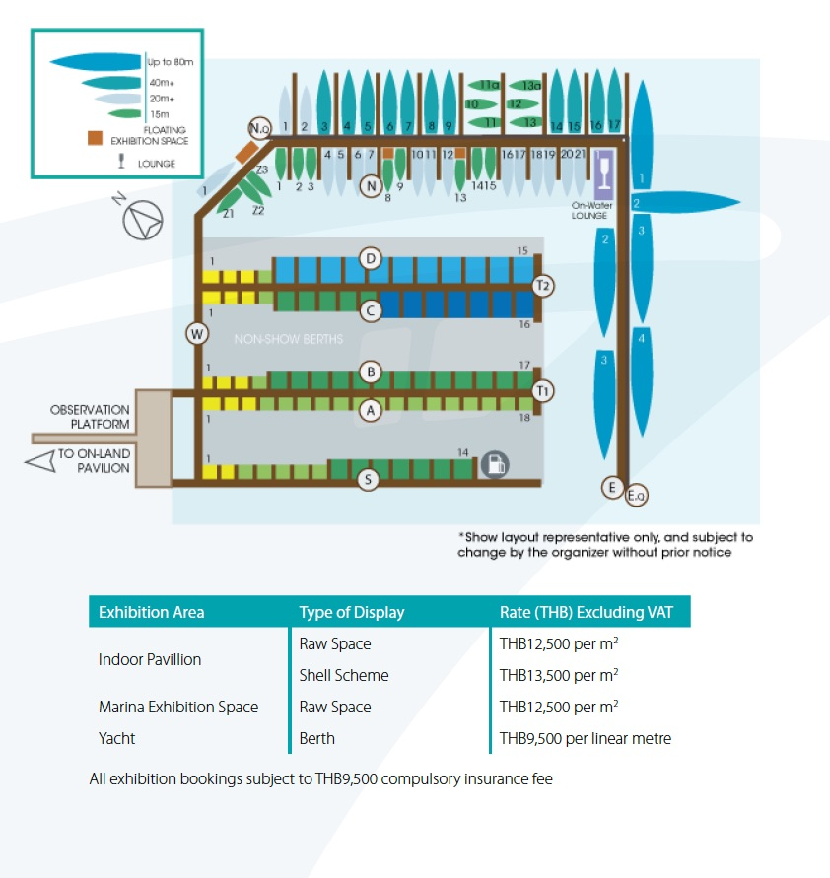
EXHIBITOR OPTIONS
Early booking is recommended to secure your preferred spot
MARINA MAP

Slide 18
MARKETING ACTIVITIES
Extensively publicised through a varied and diverse mix of marketing methods and print and online outlets
Widely promoted across both international and local stages
Beyond print and online coverage, broadcast reach is also impressive. National and international television and radio interviews are secured, which provides coverage that is key to securing the attendance of UHNWI and HNWI visitors
Direct mails, e-newsletters and the promotion of the Show’s news via social media are all used to deliver the event’s message to the target audience

Slide 19
MARKETING ACTIVITIES
Major marketing activities for the Thailand Yacht Show 2016 included:
Signage in key locations around Phuket
Bangkok-based PR agency focusing on national-level campaigns
Core marketing team working with international media to target the yachting industry, as well as wealthy individuals, boating enthusiasts and lifestyle seekers from across Asia
Strategic print and digital advertising campaigns
Cross promotion with luxury and yachting media partners
Combined marketing efforts through partners and associations
Visitor Invitations circulated to 5-star luxury hotels and inserted in media partner publications
Social media advertising campaign and targeted content

Slide 20
MARKETING ACTIVITIES
PR
The PR campaign will feature:
Media engagement and editorial in major daily business publications and monthly luxury magazines
Features on the yachting lifestyle and debuts at the show
Online campaign of advertising, editorial, blogging and social media
Creating partnerships with networks of UHNWIs and HNWIs
The event will be covered by international and local news channels, ensuring wide coverage both during and after the Show
The Thailand Yacht Show 2018 will link with business radio stations in a radio campaign to reach local target audiences

Slide 21
MARKETING ACTIVITIES

Slide 22
MARKETING ACTIVITIES
PRINT ADVERTISING
A media-wide advertising campaign will begin months before the show, focusing on key professionals from the industry, news, lifestyle and business publications enhanced with editorial content
ONLINE ADVERTISING
The marketing team will work closely with leading international industry web portals to reach subscribers and visitors through web advertising and targeted email campaigns
PREVIEW MAGAZINE
An exclusive preview magazine focuses on the latest exhibitor news, targeted interviews and yachts on display at the show. Approximately one month before the Show, the magazine is distributed to a major database of UHNWI and HNWI readers throughout the Asia Pacific region and mailed to a selected group of VIPs
INVITATIONS
The Thailand Yacht Show 2018 is an exclusive event. Invitations and personalised access passes will be mailed to qualified VIP guests internationally and regionally, as well as being distributed to Sponsors, Exhibitors and Media Partners
SOCIAL MEDIA
Communications activities across multiple social media platforms such as Facebook, Twitter, Linked In and Instagram reinforce the Show and its partners’ exposure
HOSPITALITY
Entertain customers, clients and executives at one of the world’s most beautiful marinas. The show has a plethora of official parties, as well as opportunities to entertain in the show bars and restaurants. Yachts are
always available for special exclusive entertainment
EXPERIIENTIAL MARKETING
The second edition of the Thailand Yacht Show in December 2016 attracted 4,700 visitors to meet some 75 exhibiting brands and view 55 boats and yachts in the marina

Slide 23
SINGAPORE
YACHT SHOW
SPONSORSHIP PACKAGES
12 – 15 April 2018
ONE°15 Marina Club, Sentosa Cove, Singapore
The Singapore Yacht Show is organised by Verventia Pte. Ltd. and provides a first-class platform in South East Asia’s principal business hub and financial capital for regional guests to meet yachting professionals, boat owners, supercar aficionados and a select group of invited participants keen to explore the luxury yachting scene
Held at the award-winning ONE°15 Marina Club, the Singapore Yacht Show is an exclusive event epitomising luxury lifestyle
The show brings together world-class yachts, glamorous parties, high-end entertaining, and an enviable range of prestige products and brands – supercars, fine dining, beautiful timepieces, hand-crafted jewellery and some of the region’s most luxurious waterside properties, providing the ultimate luxury experience
The 2017 edition of the Singapore Yacht Show brought together: over 14,000 visitors including 35% c-suite executives and business owners; 94 yachts, boats and watercraft, including 31 yachts over 20 metres on display in 8,400 square metres of on land and on water exhibition space; and more than 150 brands. It has won praise and unequivocal support from regional and international exhibitors for its continually growing success
TIER 1: TITLE & PRESENTING SPONSORS
One title and one presenting sponsor with naming rights to the event
TIER 2: CO-SPONSORS
Up to six co-sponsors - non-competing categories
TIER 3: LOCAL PARTNERS & MARINE INDUSTRY SUPPORTERS
Packages for Singapore & marine industry businesses
EXHIBITION ONLY PACKAGES
Packages to exhibit at the Singapore Yacht Show 2018

Slide 24
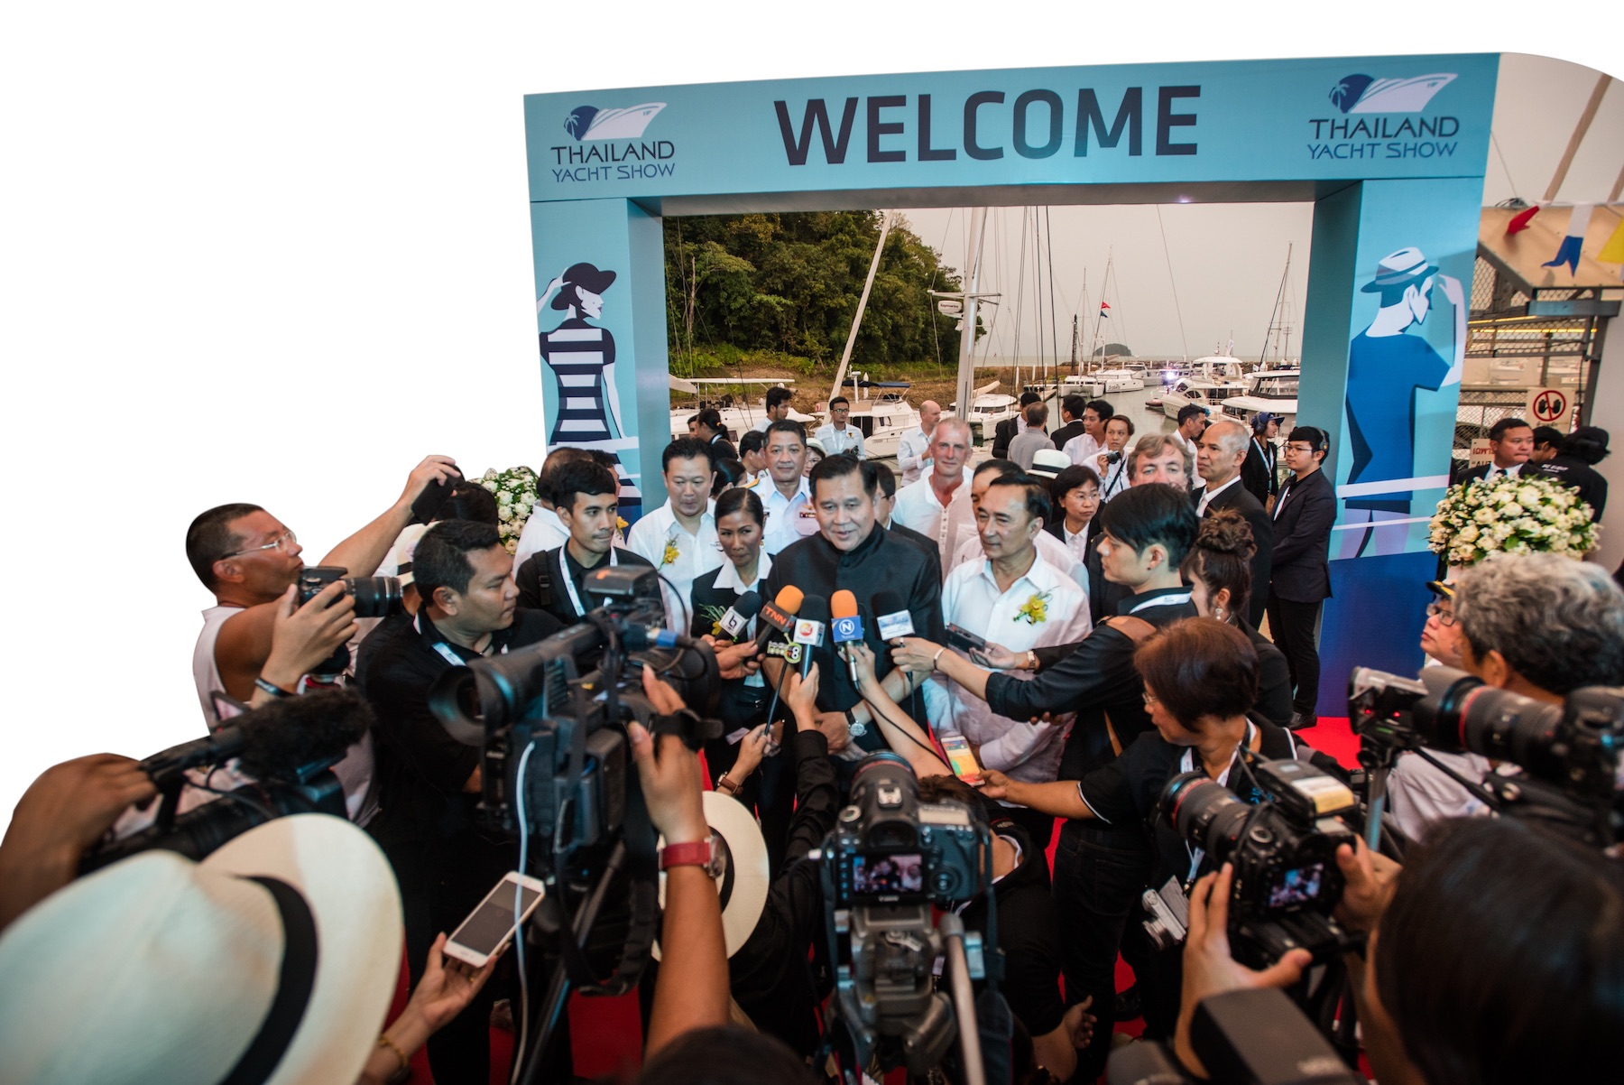
CONTACT
PAUL POOLE (SOUTH EAST ASIA) CO., LTD.
198 Tanou Road
Bovernives
Pranakorn
Bangkok 10200
Thailand
Tel./Fax: +66 2622 0605 - 7
www.paulpoole.co.th/thailandyachtshow
PAUL POOLE - MANAGING DIRECTOR
(ENGLISH SPEAKING)
Email: paul@paulpoole.co.th
Tel. +66 8 6563 3196
UDOMPORN PHANJINDAWAN - PERSONAL ASSISTANT
(THAI/ENGLISH SPEAKING)
Email: udomporn@paulpoole.co.th
Tel. +66 8 6382 9949
THAILAND YACHT SHOW
Email: info@thailandyachtshow.com
www.thailandyachtshow.com
WADE PEARCE - SHOW DIRECTOR
Email: wade@thailandyachtshow.com

