Slide 1
COMMERCIAL SPONSORSHIP &
PARTNERSHIP OPPORTUNITIES
FEBRUARY / MARCH 2017

Slide 2
INTRODUCING
ROCK ‘N’ RIDES, the world leading freestyle Motocross spectacular stunt show, is coming to Thailand in February 2017, with three shows – a main show in Bangkok with support shows planned in Chiang Mai and Phuket.
Saturday 25th February ROCK ‘N’ RIDES FMX THAILAND 2017 - BANGKOK
Saturday 4th March ROCK ‘N’ RIDES FMX THAILAND 2017 - CHIANG MAI
Saturday 11th March ROCK ‘N’ RIDES FMX THAILAND 2017 - PHUKET

Slide 3
PACKAGES – ALL EVENTS
TIER 1: TITLE SPONSORS
One title and one presenting sponsor with naming rights to ALL events
TIER 2: CO-SPONSORS
Co-sponsors from non-competing categories for ALL events
TIER 3: OFFICIAL SUPPLIERS, MEDIA PARTNERS
Official suppliers providing goods and services that are essential for ALL events
Media partners providing advertising and editorial support for ALL events
TIER 4: EXHIBITION ONLY PACKAGES
Packages to exhibit at ALL events

Slide 4
PACKAGES – SPECIFIC EVENTS
TIER 1: PRESENTING & HOST SPONSORS – SPECIFIC EVENTS
Presenting sponsors & Host sponsors for one or more events
TIER 2: CO-SPONSORS – SPECIFIC EVENTS
Co-sponsors from non-competing categories for one or more events
TIER 3: OFFICIAL SUPPLIERS, MEDIA PARTNERS – SPECIFIC EVENTS
Official suppliers providing goods and services that are essential for one or more events
Media partners providing advertising and editorial support for one or more events
TIER 4: EXHIBITION ONLY PACKAGES – SPECIFIC EVENTS
Packages to exhibit at one or more events

Slide 5
WHY GET INVOLVED?
Association with ROCK ‘N’ RIDES FMX THAILAND 2017 offers sponsors numerous benefits including:
Image Enhancement - with a spectacular international freestyle Motocross stunt festival
Brand Exposure - raising brand awareness of products and services and association with a leading international event
Hospitality Opportunities - entertaining target audiences; internal and external
Experiential Marketing - exposure to over 20,000 event attendees at Bangkok location plus over 10,000 per day at other locations
Integrated Marketing - worldwide media exposure
Networking - with business leaders
Companies associating with ROCK ‘N’ RIDES FMX THAILAND 2017 tie in with the following values: Aspirational; Major International Event; Excitement; Competition; Professionalism; Escapism; and Sport.

Slide 6
MOTOTERAPIA
MOTOTERAPIA SHOW BY VANNI ODDERA
On the show day of each event, the organisers put on a free 1-hour show for up to 100 people with disabilities.
Show riders give FMX rides and demonstrations to disabled children, attracting huge media interest for this socially fulfilling event.

Slide 7
FACTS & FIGURES
ROCK ‘N’ RIDES has entertained audiences at many events
around the world, including:
RUSSIA - MOTOTERAPIA 2016
MOSCOW SK OLYMPIYSKY
30,000+ Spectators
5 x Riders, 3 x BMX
19M Ramp
250 Jumps / 50+ Somersaults / 100% Extreme
2 x Famous Bands + 1 DJ on Stage
Sponsors: Red Bull, Bridgestone, G-drive, Moskomsport,
Gazprom, Kengooroo, NRJ Radio
MEXICO 2015
50,000+ Spectators
3 x Amazing Flip Combo
6 x Riders, 4 x BMX
2.5 x hours exciting spectacle
Sponsors: Office Depot, Rock Star, Red Bull, Jueces Drinks,
GoPro
MONTPELLIER, FRANCE
& DENVER USA 2014
45,000+ Spectators
11 x Shows around the World each year
Sponsors: Tivoli, Honor, Next Stage, Red Bull, Häagen-Dazs,
Red FX, MS Extreme, GoPro, Credit Agricole, Intel, NRG
ITALY, ROME
20,000+ Spectators
20+ Gladiators on stage
12 x Riders
Sponsors: Juke Nissan, Roma MMX, Swatch, Red Bull
RUSSIA - MOTO SHOW,
MOSCOW RED SQUARE 2010
70,000+ Spectators
12 x Riders from USA, Japan, Australia, Swiss,
Spain and New Zealand, Norway and Russia
250+ tons of sand
All national TV stations covered the event
Sponsors: Swatch, Red Bull

Slide 8
SPECTATORS
ROCK ‘N’ RIDE FMX THAILAND 2017 expects the following spectator numbers at each event per day:
Bangkok - 20,000+
Chiang Mai - 10,000+
Phuket - 10,000+
Comprising core target spectator:
12-45 years of age
Family
Active lifestyle
People who love motorcycles and concerts
The shows will attract people who are looking for active family weekend entertainment…
Chiang Mai and Phuket venues subject to change.

Slide 9
SCHEDULE
The
Subject to change
TIMING ACTIVITY
15.00 – 16.00 Mototerapia – free private Show for people with disabilities
16.00 Show opens - Competitions, Exhibitions, Attractions and
Entertainment at all times in Central Stage Zone, Expo Zone,
Funfair Zone and Moto Innovation Zone
16.30 Miss FMX Competition / Mr Hero Competition
17.30 – 19.30 FMX Show
20 min - Rider & MC Welcome
20 min - FMX Show (easy tricks)
20 min - Dance Show
20 min - FMX Show (more difficult tricks)
20 min - Fire Show
20 min - FMX Finale Show (spectacular with fireworks and music)
19.30 – 21.30 Concert featuring famous Thai acts
21.30 Ends

Slide 10
RIDERS
The
ROCK ‘N’RIDES FMX THAILAND 2017 will feature some of the world’s best freestyle motocross riders, including:
RIDER & BIKE BIOGRAPHY SPONSORS
Vanni Oddera
Italy
KTM
Vanni Oddera is a spiritual guy with many interests and talents. As a motorcycle athlete Vanni is best known as a Freestyle Moto crosser, as well as motorcycle projects for disabled children through project Mototerapia.
The Italian produces incredible bike designs – he has a degree in graphic design and revolutionises his bike every year with a special message. In 2016 Vanni’s KTM FMX bike is dedicated to nature and animals, as the psychology of the colors allow the viewer to see a change in color during a backflip.
AICS, Accossato, Alpina Raggi,
Alpinestars, Ariete, Beta Tools, Black
Bird, Dedo Racing, Herero 4°—4, KTM
Italia, Lightech, Marchald Filters,
Motorex, Nikon, Pirelli, Scalvini,
Scorpion Bay, SIXS, SM Sospensioni,
Sony Action Cam, Termignoni,
UFO Plast
Massimo Bianconcini
Italy
KTM 250SX
Massimo started in motocross in 1987. His recent results include: 1st place whip contest Kings of freestyle Lipzia (DE); 1st speed and style World Cup Berlin (DE); 1st whip contest World Cup Berlin (DE); 1st place Stick the Trik Bressanone; 1st place speed and style World Cup Sanlurfia Turkia; 2nd place highest air World Cup Ostrava; 2nd place highest air World Cup Vienna; 1st place highest air World Cup Fortaleza Brazil; 5th place in the World Cup 2010.
Daboot, KTM, DC, AXO, Speedrace
Energy Drink, X-Lite, TCX, Marzocchi,
Oakley, Goldentire, Race Tech, Luter,
GB Ink, Mob Sidacate, Logic, Black
Bird, Scarrov

Slide 11
RIDERS
The
RUN ‘N’RIDE FMX THAILAND 2017 will feature some of the world’s best freestyle motocross riders, including:
RIDER & BIKE BIOGRAPHY SPONSORS
Luca Zironi
Italy
KTM 250 2T
Luca made his debut in motocross in 2001 by participating in the Regional Motocross
Championship 125 aged under 20 and concluded the season in 5th place.
Luca is one of the world’s top FMX riders and has made numerous appearances in top events both national and international, such as: Red Bull, The Milan EICMA show and the Supercross of Genova.
DC Shoes, Nils oil, Dunlop, Alpina,
Tenneco Marzocchi, Acerbis, Google,
Black Bird, Lazer, Leovince, SIX2,
Gaerne, Pedro suspension, Daboot
Ivan Zucconi
Ivan Zucconi
Italy
KTM 250 2T
In 2013, Ivan was invited to the 02 Arena in London for the Nitro Circus Travis Pastrana. With him were the strongest freestylers in the world, and together they performed a collective backflip for Guinness world records, with eighteen participating bikers.
Ivan has style and technique, and to see him perform is pure spectacle. In addition to being part of the DC team, he is also a member of Daboot, freestyle team.
UFO Plast, Goldentyre, LB Design,
Alpinestar, DC, Beans, Pegas,
Marzocchi

Slide 12
ZONES
The world-class shows comprise four zones:
Central Stage Zone - with an FMX Stunt Show featuring four of the world’s best riders; four Thai FMX riders; a Miss FMX Competition; culminating with an open-air concert headlined by top Thai acts
Funfair Zone - with amusements and fun sports activities for the whole family, including game stations, motor rides, rock climbing, rodeo rides, and more…
Moto Innovation Exhibition Zone - featuring an exhibition of bikes past and present
Expo Zone - with sponsor stalls, 50+ shops (rental spaces ranging from 9 – 18 sqm), food and drink

Slide 13
TICKET SALES
Tickets for the events will be sold through Event Pop.
VIP tickets cost 2,500 THB and include: meet & greet and photo/autograph with riders; front row area seats; private bar with a welcome drink; fast entrance; and 1 x lottery tickets.
General tickets cost 1,000 THB and include a lottery ticket.

Slide 14
PROMOTIONAL CHANNELS
The events will be promoted through:
Boxza Racing
Facebook
Google!
PPTV HD
Radio Thailand
Siamsport Channel
SMMTV
Thailand Superbike
True Sport
YouTube

Slide 15
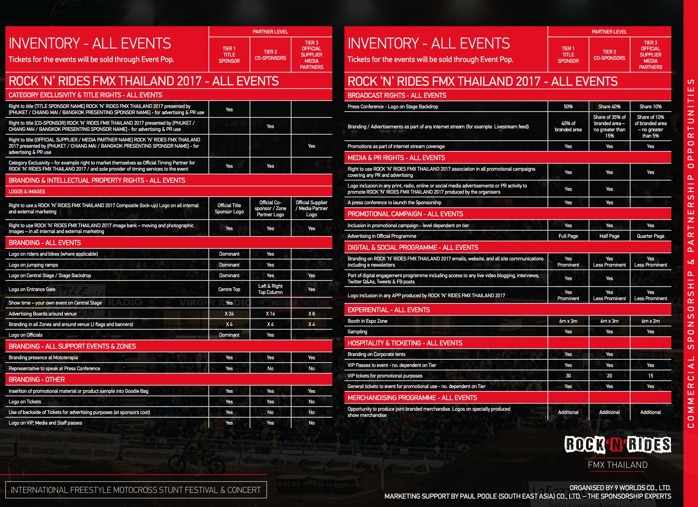
INVENTORY - ALL EVENTS

Slide 16
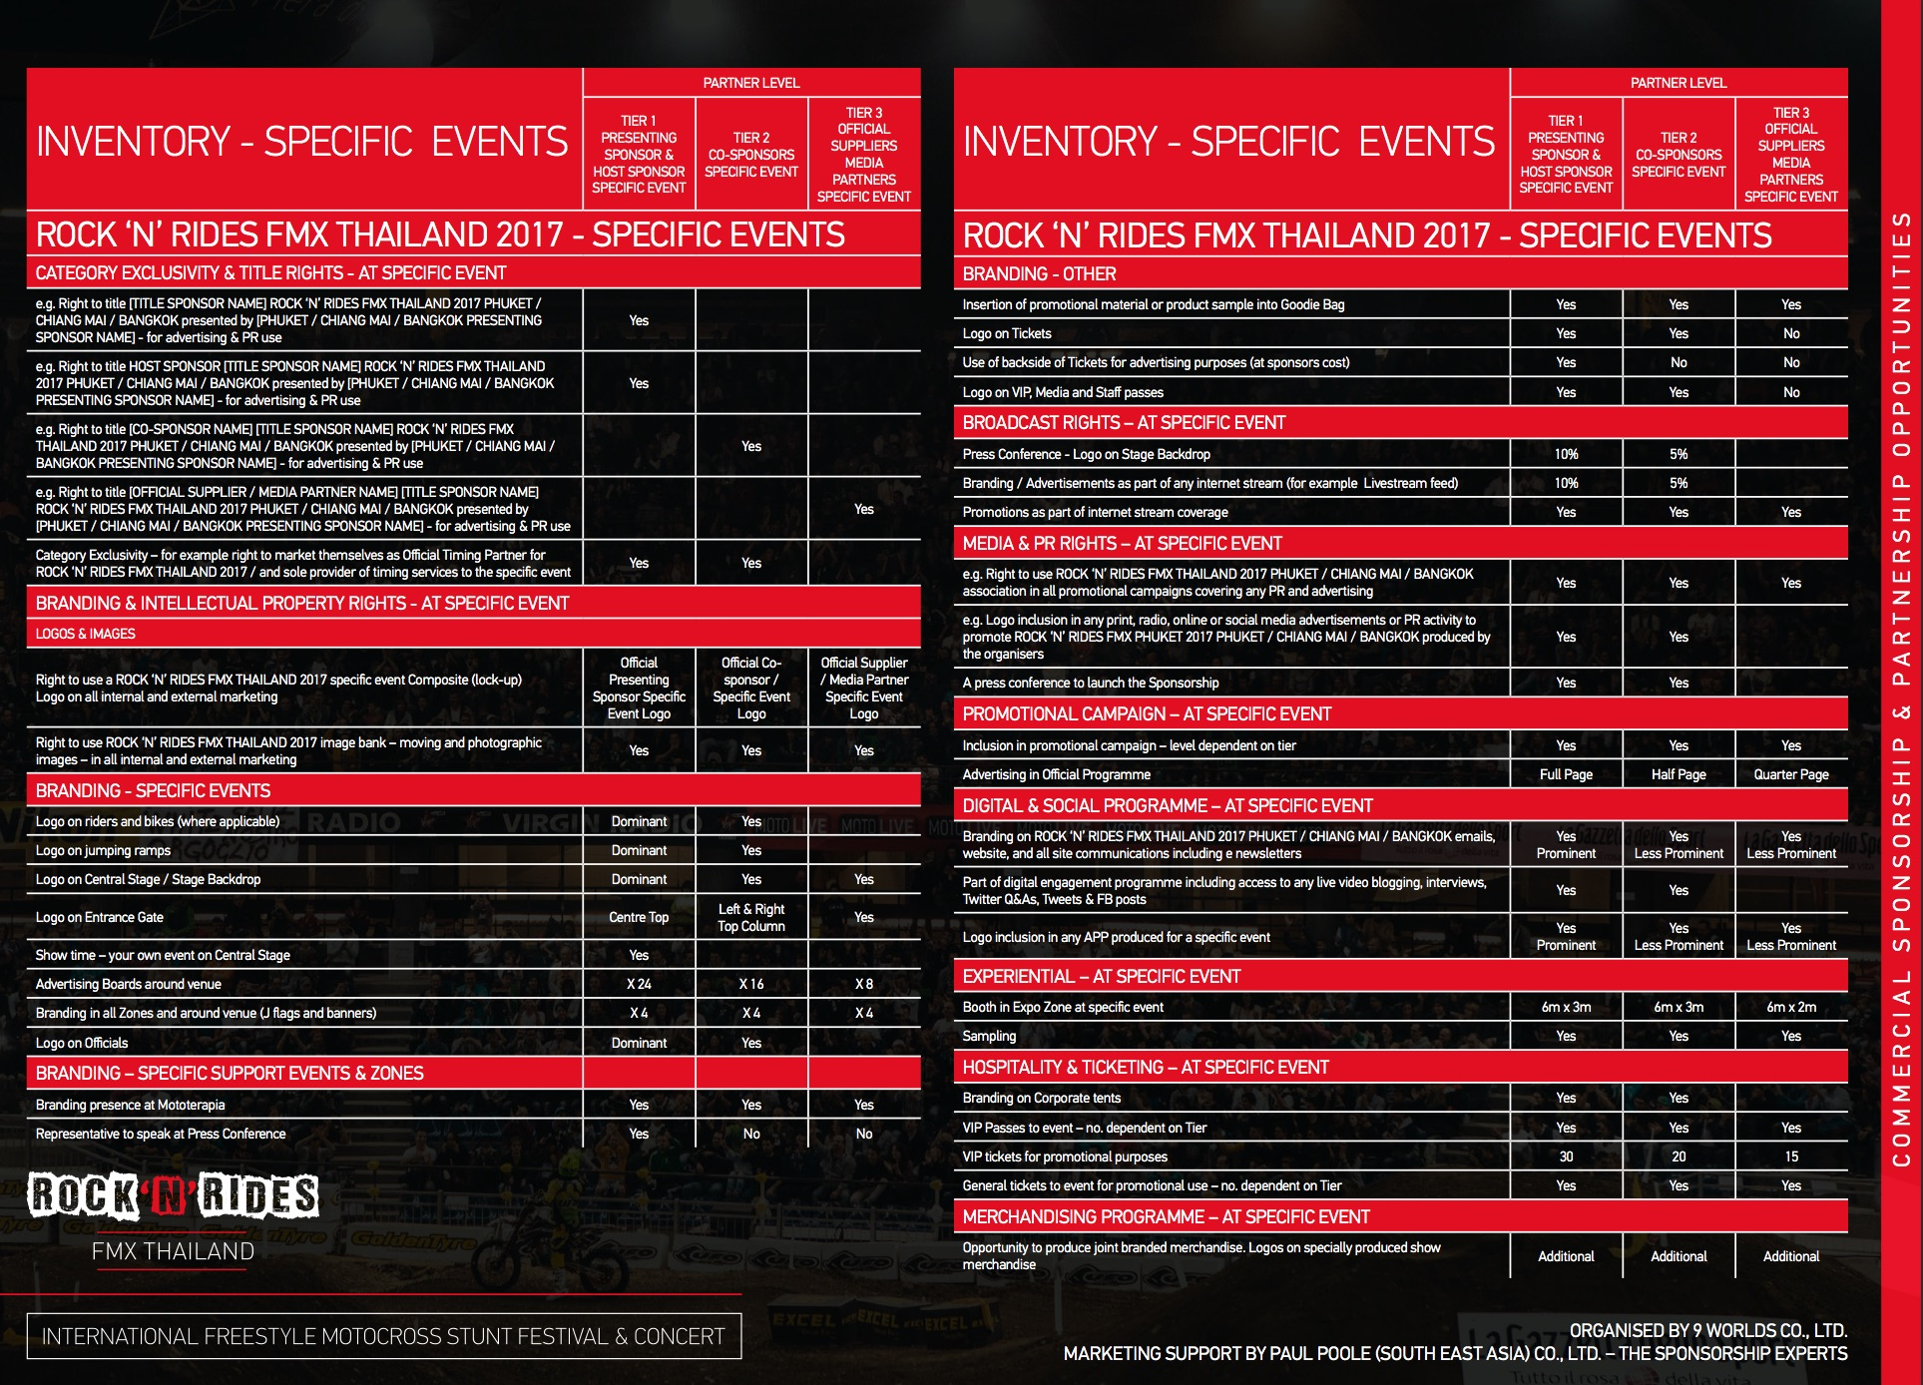
INVENTORY - SPECIFIC EVENTS

Slide 17
Being part of the Expo Zone at ROCK ‘N’ RIDES FMX THAILAND 2017 is a fantastic opportunity to promote and sell goods and services with over 20,000 attendees each day expected.
EXHIBITOR OPTIONS
Being part of the Expo Zone at ROCK ‘N’ RIDES FMX THAILAND 2017 is a fantastic opportunity to promote and sell goods and services with over 20,000 attendees each day expected.

Slide 18
MARKETING ACTIVITIES
BRANDING
ROCK ‘N’ RIDES FMX THAILAND 2017 has many high profile branding opportunities ensuring Sponsors have high visibility, before, during and after the event. These include:
Event Branding in all four Zones
Central Stage
Funfair
Moto Innovation
Expo
See inventory for full details.

Slide 19
MARKETING ACTIVITIES
MEDIA & PR
MEDIA PARTNERSHIPS
ROCK ‘N’ RIDES FMX THAILAND 2017 is seeking a maximum of 10 media partnerships.
Sponsors and Partners will benefit from editorial and advertising coverage with these media.
PR SUPPORT
Sponsors can create media coverage through news PR activity. There will be coverage in local and national newspapers, Asian regional and international newspapers, TV, Radio and Magazines. Press releases will also be issued through a variety of regional and international motorcycle web sites.
All Sponsors and Partners will have rights to associate with ROCK ‘N’ RIDES FMX THAILAND 2017 for PR and advertising activity.

Slide 20
MARKETING ACTIVITIES
EXPERIENTIAL
With over 50,000 spectators expected at the three events ROCK ‘N’ RIDES FMX THAILAND 2017 offers a great opportunity for brands to sample and distribute their products and services.
HOSPITALITY
ROCK ‘N’ RIDES FMX THAILAND 2017 offers a plethora of fantastic opportunities to entertain customers, clients and executives at the three events in Thailand.
This is an excellent way to do and promote your business.
Sponsors will have a number of opportunities to entertain their guest through bespoke packages.
MERCHANDISING
ROCK ‘N’ RIDES FMX THAILAND 2017 offers Sponsors and Partners the opportunity to produce joint branded merchandise. This could be used as give-away through media and presence marketing promotions. For example: ROCK ‘N’ RIDES FMX THAILAND 2017 Goodie Bags.

Slide 21
CONTACT
PAUL POOLE (SOUTH EAST ASIA) CO., LTD.
198 Tanou Road
Bovernives
Pranakorn
Bangkok 10200
Thailand
Tel./Fax: +66 2622 0605 - 7
www.paulpoole.co.th/rocknrides
PAUL POOLE - MANAGING DIRECTOR (ENGLISH SPEAKING)
email: paul@paulpoole.co.th
Tel. +66 8 6563 3196
UDOMPORN PHANJINDAWAN - PERSONAL ASSISTANT
(THAI/ENGLISH SPEAKING)
email: udomporn@paulpoole.co.th
Tel. +66 8 6382 9949
ROCK ‘N’ RIDES FMX THAILAND
9 Worlds Co., Ltd.
135/9 Amornphan 205 Tower 2 Soi Ratchadaphisek 7
Ratchadaphisek Road
Dindaeng
Bangkok 10400
www.9worlds.asia
www.rocknrides.asia
VALERY GLUSHKOV – DEVELOPMENT DIRECTOR (RUSSIAN/ENGLISH SPEAKING)
email: v.glushkov@9worlds.asia
Tel. +66 9 0069 0121
CHANPRAPA KART-O-SOD – MANAGER (THAI/ENGLISH SPEAKING)
email: event@rocknrides.asia
Tel. + 66 9 5719 6467

