Slide 1
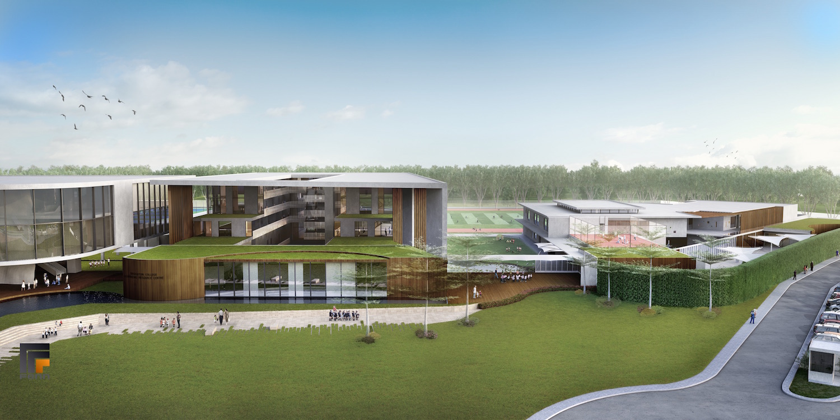


COMMERCIAL
SPONSORSHIP & PARTNERSHIP
OPPORTUNITIES
MARKETING SUPPORT BY PAUL POOLE (SOUTH EAST ASIA) CO., LTD. - THE SPONSORSHIP EXPERTS

Slide 2
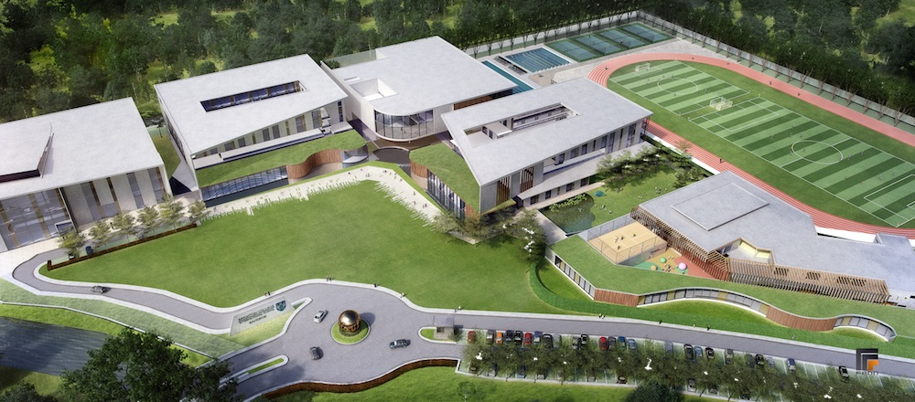
INTRODUCING…
Set on a 20-acre campus, Brighton College Bangkok (BCB) is a collaborative effort between Brighton College UK, one of England’s leading schools, and Ocean Group, the Thai corporation led by the Assakul family.
BCB will open in September 2016, with capacity for 1,500 boys and girls aged 2 to 18.
MARKETING SUPPORT BY PAUL POOLE (SOUTH EAST ASIA) CO., LTD. - THE SPONSORSHIP EXPERTS

Slide 3
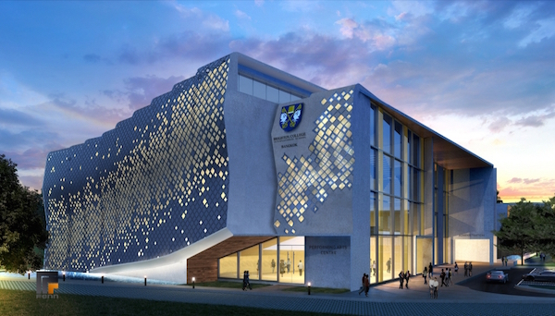
INTRODUCING…
Offering the full Brighton College experience. Set to become the leading British curriculum school in Thailand.
Purpose-built state-of-the-art-facilities for music, art, dance, drama, sports and co-curricular activities.
MARKETING SUPPORT BY PAUL POOLE (SOUTH EAST ASIA) CO., LTD. - THE SPONSORSHIP EXPERTS

Slide 4
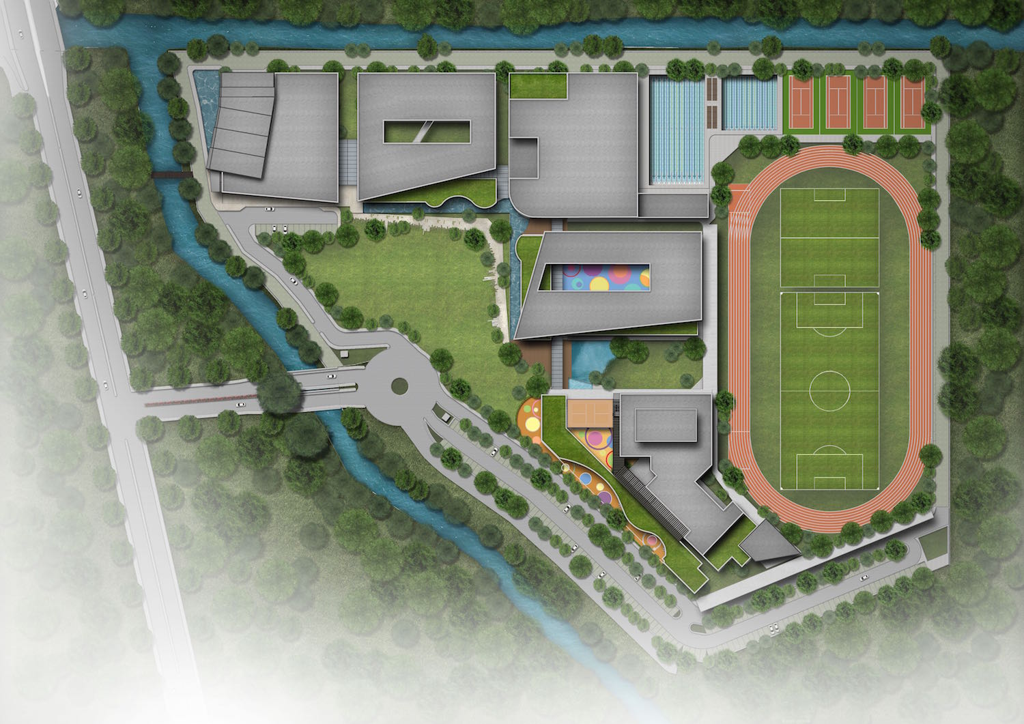
CAMPUS DESIGN
Design of the BCB campus is a fundamental part of BCB’s vision for learning.
BCB provides an inspirational learning environment.
BCB connects children with nature - seamless integration between interior and exterior will enable children to learn in innovative ways, making them feel part of the world around them.
BCB embraces tomorrow and the impact digital technology has on children’s lives.
MARKETING SUPPORT BY PAUL POOLE (SOUTH EAST ASIA) CO., LTD. - THE SPONSORSHIP EXPERTS

Slide 5
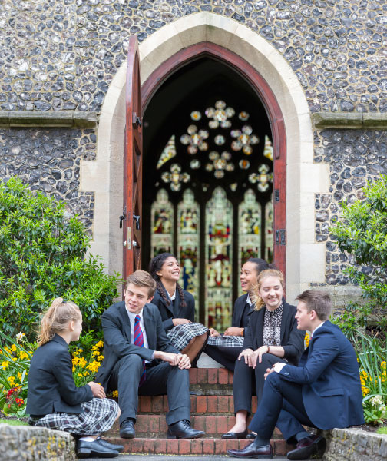
INTERNATIONAL NETWORK
BCB will be the third Brighton College International Schools (BCIS).
Brighton College Abu Dhabi - opened in Abu Dhabi on a state-of-the-art campus in 2011 and has a current roll of 1,600 pupils.
Brighton College Al Ain - opened in 2013. By 2018, the college will educate 1,200 pupils across the 3 to 18-age range on its state-of-the-art campus, located in the ancestral city of the ruling family of the United Arab Emirates.
MARKETING SUPPORT BY PAUL POOLE (SOUTH EAST ASIA) CO., LTD. - THE SPONSORSHIP EXPERTS

Slide 6
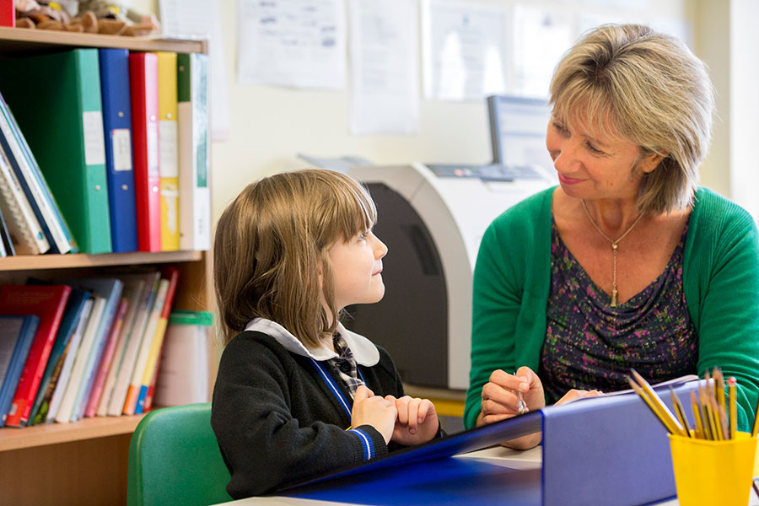
VISION…
BCIS’s vision is to work with investors to open a series of premium international sister schools modeled upon Brighton College. Each school shares Brighton College UK’s aims and ethos, achieved by focusing on:
Appointing excellent teachers
Supporting excellent and inspirational teaching
Support outside the classroom - to consolidate and to extend
A balanced life at school
MARKETING SUPPORT BY PAUL POOLE (SOUTH EAST ASIA) CO., LTD. - THE SPONSORSHIP EXPERTS

Slide 7
SENIOR TEAM
DAVID TONGUE - is BCB’s founding Headmaster. Currently Headmaster of Brighton College Al Ain in the UAE, his school was recently awarded the highest ever inspection grade given to a school Emirates.
He is 39 years old, is married to Victoria, and they have two young children who will both attend BCB.
KELLY CROMPTON - is Head of Pre-Prep, responsible for the education of the College’s youngest children aged 2 to 8.
MARKETING SUPPORT BY PAUL POOLE (SOUTH EAST ASIA) CO., LTD. - THE SPONSORSHIP EXPERTS

Slide 8
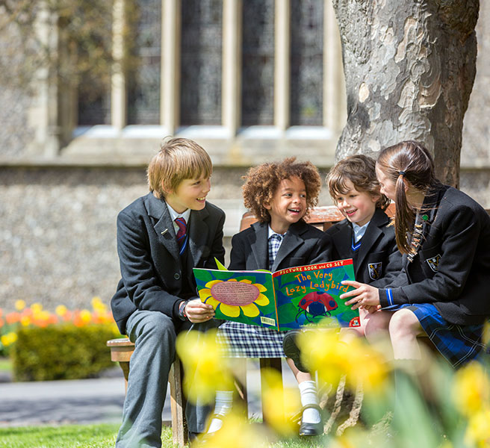
THE SCHOOLS
Official Sponsors will have the opportunity to integrate their brand with BCB’s three main school sections:
The Pre-Prep School
Pre-Nursery to Year 3 - Ages 2-8
The Preparatory School
Years 4 to 8 - Ages 8-13
The Senior School
Years 9-13 - Ages 13-18
MARKETING SUPPORT BY PAUL POOLE (SOUTH EAST ASIA) CO., LTD. - THE SPONSORSHIP EXPERTS

Slide 9
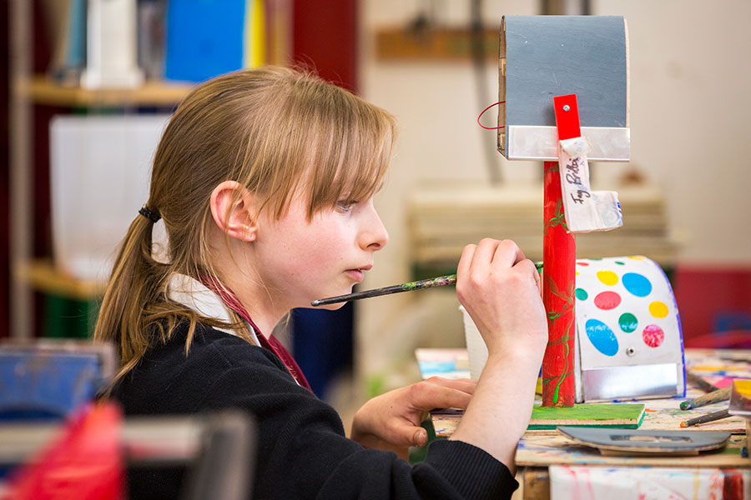
MAJOR FACILITIES
PERFORMING ARTS CENTER (PAC)
Houses a 620-seat theatre, dance studios, rooms for musical instruction and practice, art and design rooms, Mac suites and a traditional photography darkroom.
Pupils in all years have access to this superb resource, which will actively promote one of the core values of Brighton College, namely the importance of the arts in all our lives.
MARKETING SUPPORT BY PAUL POOLE (SOUTH EAST ASIA) CO., LTD. - THE SPONSORSHIP EXPERTS

Slide 10
MAJOR FACILITIES
SPORTS FACILITIES
Brighton College Bangkok aims to become one of the leading colleges in the Federation of British International Schools in Asia (FOBISIA).
Olympic-sized 50m Swimming Pool
25m Swimming Pool
State-of-the-art Athletics track
Full-sized Football pitch and a training pitch
4 Tennis Courts
3 Basketball Courts with a viewing platform
MARKETING SUPPORT BY PAUL POOLE (SOUTH EAST ASIA) CO., LTD. - THE SPONSORSHIP EXPERTS

Slide 11
MAJOR FACILITIES
LEARNING RESOURCE CENTER (LRC)
Linking the academic buildings together - a wide, glass-fronted open plan space that flows from the Senior School, through to the Prep School and Pre-Prep.
Includes spaces for collaboration, creativity, quiet study, small group presentations and performances, tying together learning across the school.
The LRC fronts onto outdoor learning spaces, which will encourage children of all ages to learn from the natural world.
MARKETING SUPPORT BY PAUL POOLE (SOUTH EAST ASIA) CO., LTD. - THE SPONSORSHIP EXPERTS

Slide 12
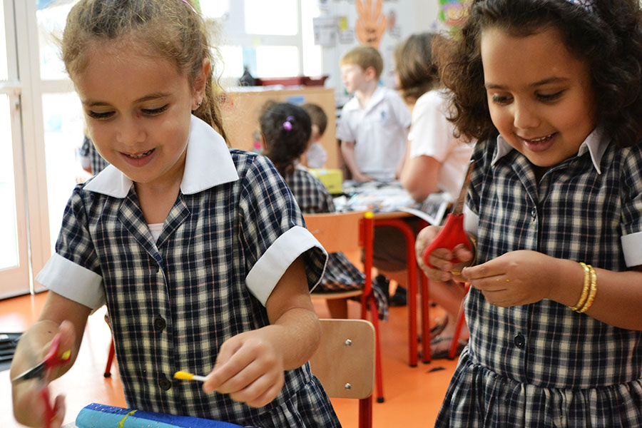
CURRICULUM
Unique in that all pupils will learn English, Thai and Mandarin.
Follows the British independent educational model with the school composed of three different sections: a Pre-Prep School, Preparatory School and Senior School.
The innovative Brighton College UK curriculum, leading to the award of IGCSEs and A-levels/IB.
Outstanding pastoral care delivered through the traditional ‘House’ system.
A caring, supportive and tolerant environment to thrive and develop a lifelong passion for learning.
MARKETING SUPPORT BY PAUL POOLE (SOUTH EAST ASIA) CO., LTD. - THE SPONSORSHIP EXPERTS

Slide 13
SPECIAL EVENTS
Throughout the year, BCB organises signature events, including Science Festivals, Music Performances, Art Exhibitions and Sports Tournaments, including the Federation of British International Schools in Asia Games.
EVENTS INCLUDE:
Lavish school productions Prize giving and awards ceremonies
Parent association events Exhibitions
Welcome barbeques Summer balls
Garden parties Co-curricular events (Model United
Showcasing events Nations, Debating Tournaments)
Naming rights to the BCB Special Events are available.
MARKETING SUPPORT BY PAUL POOLE (SOUTH EAST ASIA) CO., LTD. - THE SPONSORSHIP EXPERTS

Slide 14
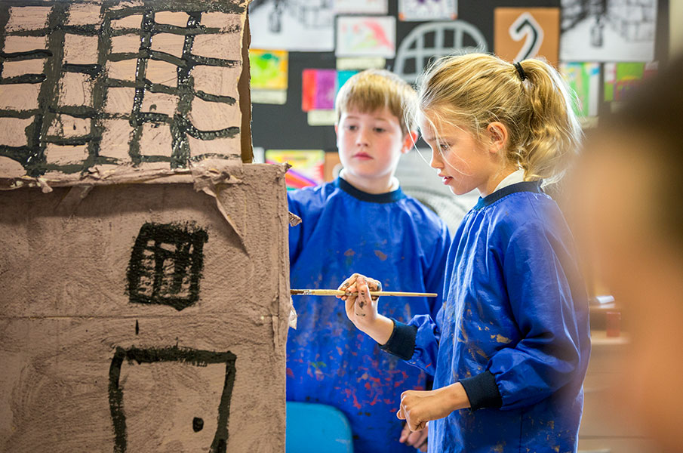
SCHOLARSHIPS
To enable the best to access the best.
BCB has a number of opportunities for businesses to support students through sponsorship of scholarships.
These can be done on an individual basis or can also be added to other commercial packages.
MARKETING SUPPORT BY PAUL POOLE (SOUTH EAST ASIA) CO., LTD. - THE SPONSORSHIP EXPERTS

Slide 15
MICE
BCB’s campus, its academic, creative and performing arts and sporting facilities make it the ideal destination for companies seeking something uniquely memorable for their next business event, product launch, incentive, executive retreat or teambuilding outing.
BCB OFFERS:
Sports facilities
Seminar facilities
Conference rooms
Auditorium
Swimming pools
MARKETING SUPPORT BY PAUL POOLE (SOUTH EAST ASIA) CO., LTD. - THE SPONSORSHIP EXPERTS

Slide 16
BENEFITS
Brand Exposure & Image Enhancement
Supporting The Future Of The Arts, Business & Sport
Networking & Hospitality
Experiential Marketing
Corporate Social Responsibility
World Class Teaching & Coaching & World Class Venues
MARKETING SUPPORT BY PAUL POOLE (SOUTH EAST ASIA) CO., LTD. - THE SPONSORSHIP EXPERTS

Slide 17
PACKAGES
Tier 1 - Official Sponsors
Naming Rights To Major Facilities e.g. Learning Resource Centre; Performance Arts Centre; Sports Facilities; etc.
Tier 2 - Official Suppliers (all from non-competing categories)
From different industries that can provide supplies
Tier 2 - Media Partners
Providing media support
Tier 3 - Special Event Partners
Packages for special events held at BCB Schools and Facilities
Other Opportunities
Scholarship Programme
Meetings, Incentives, Conferences & Exhibitions (MICE)
MARKETING SUPPORT BY PAUL POOLE (SOUTH EAST ASIA) CO., LTD. - THE SPONSORSHIP EXPERTS

Slide 18
CONTACT
Paul Poole (South East Asia) Co., Ltd.
198 Tanou Road
Bovernives, Pranakorn
Bangkok 10200
Thailand
Tel./Fax: +66 2622 0605 - 7
www.paulpoole.co.th/brightoncollegebangkok/
Paul Poole - Managing Director (English Speaking)
email: paul@paulpoole.co.th
Tel. +66 8 6563 3196
Udomporn Phanjindawan – Personal Assistant (Thai/English Speaking)
email: udomporn@paulpoole.co.th
Tel. +66 8 6382 9949
Brighton College Bangkok
Soi Krungthep Kreetha 15/1
Krungthep Kreetha Road
Huamark, Bangkapi
Bangkok
Tel: +66 2512 1872
www.brightoncollegebangkok.com
www.brightoncollegeinternational.com
www.brightoncollege.org.uk
Varissara Assakul - Project Coordinator (Thai/English Speaking)
email: Varissara@brightoncollegebangkok.com
Tel. +66 8 1443 5552 or +66 9 2468 2222
Thanchanok Loviriyanan - Marketing Co-ordinator (Thai/English Speaking)
email: thanchanok.l@brightoncollegebangkok.com
Tel. +66 9 2698 2288
MARKETING SUPPORT BY PAUL POOLE (SOUTH EAST ASIA) CO., LTD. - THE SPONSORSHIP EXPERTS

