Slide 1
Commercial Sponsorship
&
Partnership Opportunities
OFFICIAL CAMERA
Spring 2015

Slide 2
INTRODUCING…
Award-winning English-medium, co-educational, day & boarding school
Internationally renowned stable of Sporting Academies – Golf, Tennis, Swimming and Football
Some of the best school facilities in South East Asia
Art & Design Academy & Business Academy
Extra-curricular activities providing access to everything from trapeze to recycling clubs!

Slide 3
FACTS
840 day and boarding international students from 50+ countries
Pre-school, Primary and Secondary school education - highest international standard
Key stages 1, 2 & 3 based upon the National Curriculum of England and Wales
Two-year IGCSE Programme, Years 10 & 11; IB Diploma Programme, Years 12 & 13
100+ fully qualified, full-time teachers from 16 different countries plus 40 Thai teaching assistants
Students gaining entry to over 120 leading universities worldwide in last five years

Slide 4
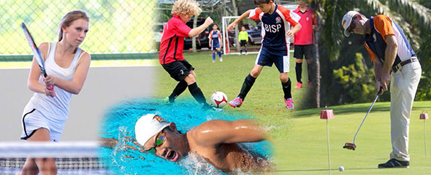
SPORTS ACADEMIES
Four main Sport Academies… Football, Tennis, Swimming and Golf
Vision is to develop and produce world-class athletes competing at the highest level
Each Sports Academy has coaches with outstanding experience in working with high performance team (HPT) level sportsmen and sportswomen

Slide 5
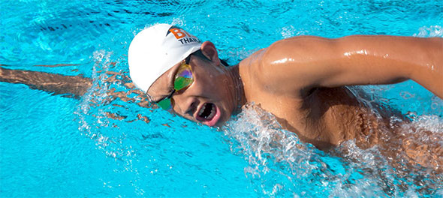
SWIMMING
BISP JSA Swim Academy - one of Asia’s best Swimming Academies with Olympic 50-metre & 25-metre pools
18 National Records & five qualifiers for the 2014 FINA World Swimming Championship
Flying Fish Swim Club - extensive swimming programme
Swim Academy Head Coach, Simon Jones, MSc. Currently works with 15 International Age Group Swimmers, including three Youth Olympic Games athletes, one Asian Games finalist and two World Championship qualifiers

Slide 6
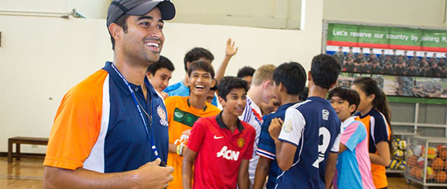
FOOTBALL
The BISP Cruzeiro Football Academy is a joint programme run by BISP and Brazilian side Cruzeiro Esporte Clube, the 2014 national Brazilian champions
Students learn Brazilian way of playing under Brazilian Head Coach, Jonathas
Three 11-a-side or eleven 7-a-side football pitches - one of the largest school capacities in Asia
Annual events include BISP Soccer Sevens each November; Asia’s largest such event

Slide 7
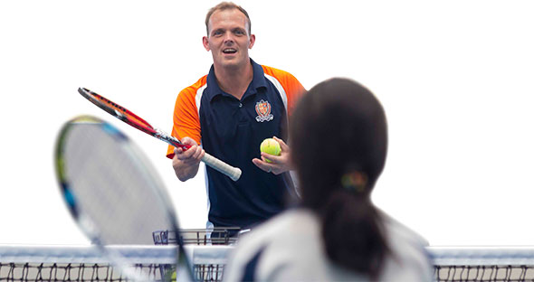
TENNIS
Producing outstanding young tennis players with access to world-class coaching and teaching under professional coach, Lee Austrin
Six courts - three covered and three uncovered
Follow the Spanish methodology of coaching – Registro Professional de Tenis (RPT)
Top players are entered into tournaments and receive Thai ranking points to ensure national recognition
The very best prospects have the chance to attend top training camps in Spain

Slide 8
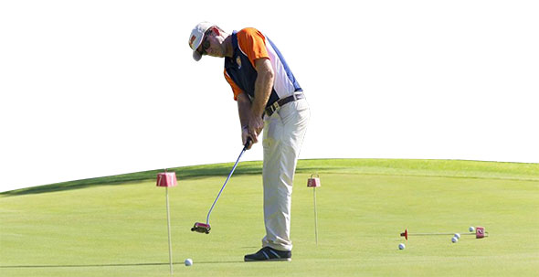
GOLF
All levels, from primary school to senior school and elite golfer
Headed up by British professional Oliver Bates
Building a dedicated golf centre on site, with driving range, bunkers and greens
Develop and refine all students’ golfing skills through technical, mental, tactical and physical strategies
Sessions at BISP, Loch Palm Golf Course or the Phunaka Golf Academy video studio and 9-hole academy course

Slide 9
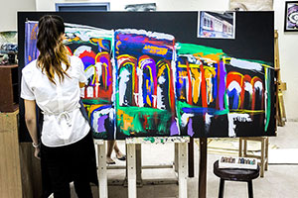
ART & DESIGN
All students study Music, Art and Drama up until the end of year 9
After year 9, students can select arts subjects as part of IGCSE and IB Diploma Programmes
Art & Design - 100% pass rate at IB Diploma Visual Arts and at IGCSE Art and Design. BISP has been top in the World in IGCSE Art and Design 2009 and 2011
Music - Students enter for external UK Rockschool examinations as well as ABRSM exams
Drama & Theatre - Each year, BISP hosts a major school production – a major event on Phuket's cultural calendar, and play to full houses

Slide 10
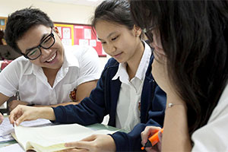
BUSINESS ACADEMY
Initiative between the school, business communities, educators and volunteers created in 2014
Inspiring business-minded young people to dream big and achieve their potential
In teams set up as actual businesses, Business Academy students develop their own market entry strategy for a product or service
Academy students experience real-time trading of stocks on the financial market, an experience that will prepare them for the dynamic world of financial trading

Slide 11
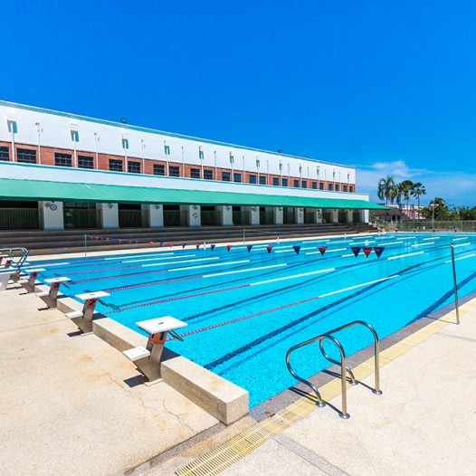
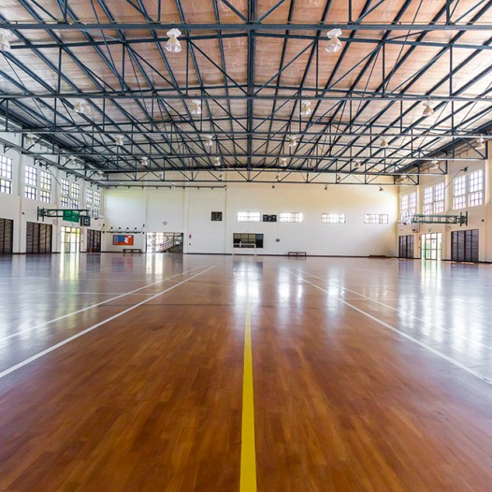
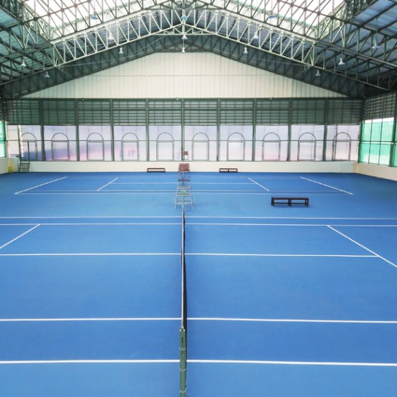
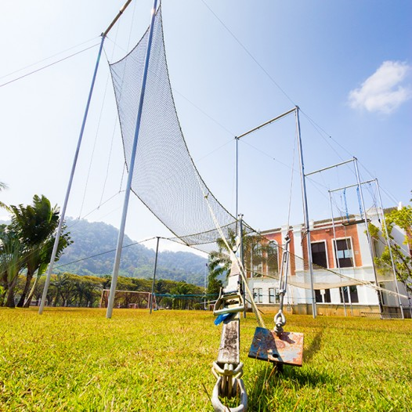
MAJOR FACILITIES
Football Stadium
Swimming Pools
BISP Ice Arena
Arts Centre
Golf Centre
Tennis Centre
Gym / Strength & Conditioning Programme
Sports Hall / Indoor Arena
Trapeze

Slide 12
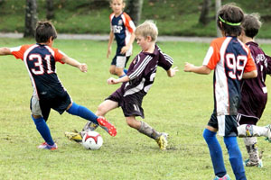
SPECIAL EVENTS
BISP Academies and Major Facilities organize signature events throughout the year
The first such special event available for sponsorship is the Football Academy Soccer Sevens
Held in November, the largest such schools tournament in Asia
More than 120 teams from 35 different international schools, 1,350 competitors from 8 different countries

Slide 13
SCHOLARSHIPS
To enable the best to access the best
BISP has a number of opportunities for businesses to support students through sponsorship of scholarships within each of the academic, arts and sports academies and also general academia
These can be done on an individual basis or can also be added to other commercial packages

Slide 14
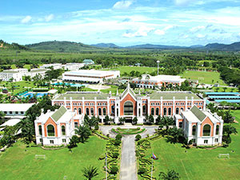
MICE
BISP’s sprawling grounds and high performance sporting facilities make the ideal destination for companies seeking something uniquely memorable for their next business event, product launch, incentive, executive retreat or teambuilding outing
Sports Facilities
Seminar Facilities
400 Seat Auditorium
40-60 Seat Theatre Style Conference Room

Slide 15
BENEFITS
Supporting the Future of the Arts, Business and Sport
Brand Exposure & Image Enhancement
Networking & Hospitality
Experiential Marketing
Corporate Social Responsibility
World Class Teaching & Coaching
World Class Venues

Slide 16
PACKAGES
Tier 1: Official Sponsors
Naming Rights To Academies & Major Facilities
- High Performance Sports Academies – Swim; Tennis; Football; Golf
Art & Design Academy & Business Academy
Other Major Facilities
Tier 2: Official Suppliers & Media Partners
From different industries that can provide supplies – all from non-competing categories
Providing media support
Tier 3: Special Event Partners
Packages for special events held at BISP - each academic, arts and sports academy/facility holding a signature event/events each year, e.g. Football Academy Soccer Sevens
Other Opportunities
Scholarship Programme
Meetings, Incentives, Conferences & Exhibitions (MICE)

Slide 17
CONTACT
Paul Poole (South East Asia) Co., Ltd.
198 Tanou Road Bovernives Pranakorn Bangkok 10200 Thailand Tel./Fax: +66 2622 0605 - 7 www.paulpoole.co.th/bisphuket
Paul Poole - Managing Director (English Speaking) email: paul@paulpoole.co.th Tel. +66 8 6563 3196
Udomporn Phanjindawan – Personal Assistant (Thai/English Speaking) email: udomporn@paulpoole.co.th Tel. +66 8 6382 9949
British International School, Phuket
59 Moo 2, Thepkrasattri Road T. Koh Kaew, A. Muang Phuket 83000 Thailand Tel: +66 (0) 76 335 555 Fax: +66 (0) 76 335 578 www.bisphuket.ac.th
Simon Ostheimer – Marketing & Communications Manager (English Speaking) email: sostheimer@bisphuket.ac.th Tel. +66 (0) 76 335 555 ext. 1113

