Slide 1
Integrate your marketing with…
2-4 NOVEMBER 2018
13-16 DECEMBER 2018

Slide 2
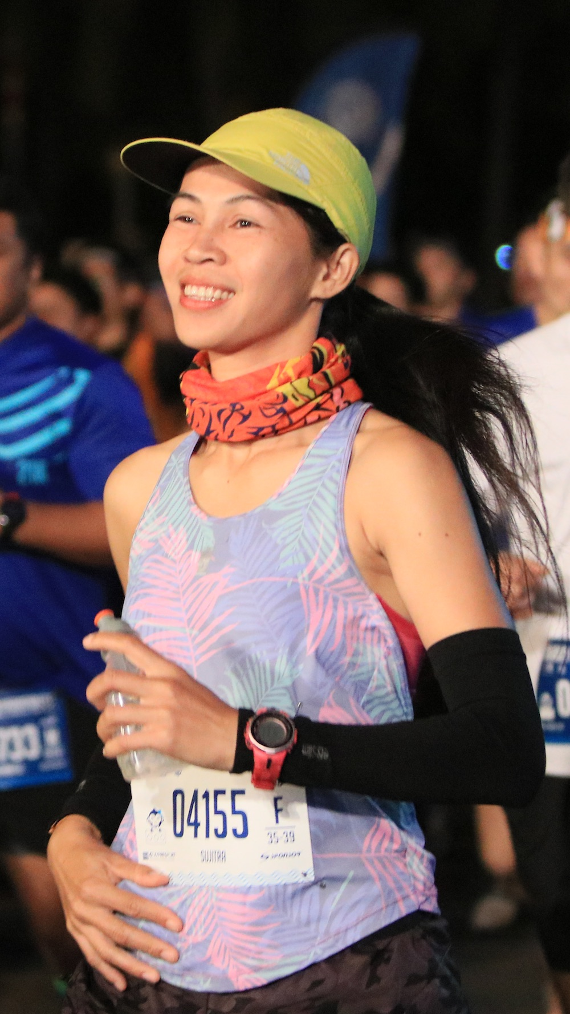
BANGSAEN42-2018 & Bangsaen21-2018
Commercial sponsorship and partnership marketing opportunities for two of Thailand and Asia’s leading full and half marathon events…
BANGSAEN42-2018
Friday 2nd - Sunday 4th November 2018
Now in its second year, the BANGSAEN42-2018 MARATHON attracts both Thai and international runners, with over 6,034 runners attending the inaugural event in 2017.
Bangsaen21-2018
Thursday 13th - Sunday 16th December 2018
Now in its fourth year, Bangsaen21-2018 has been awarded “Best Half Marathon” running event in Thailand for three consecutive years.
Both BANGSAEN42-2018 & Bangsaen21-2018 includes an Expo for Sponsors to promote their products and services as well as Parties & VIP Hospitality.

Slide 3
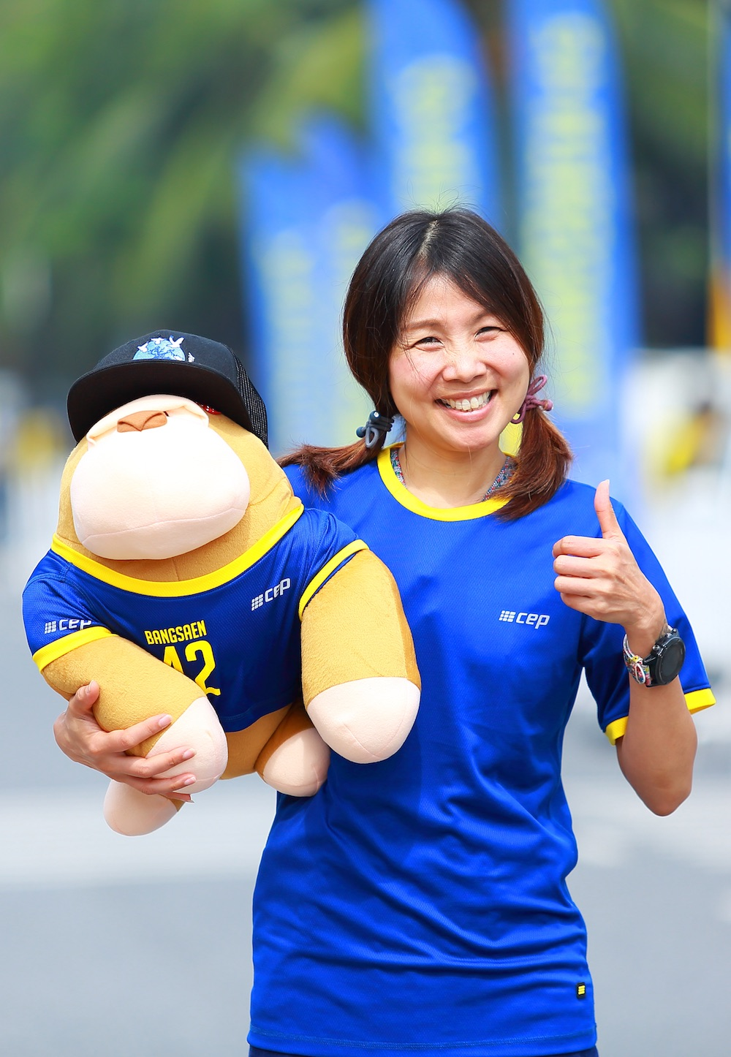
BANGSAEN42-2018 2nd – 4th November 2018
Organised by MICE & Communication Co., Ltd. and Chonburi’s Saensuk Municipality, BANGSAEN42 MARATHON has been awarded the popular title “Best Marathon” running event in Thailand.
The race is a member of The Association of International Marathons and Distance Races (AIMs) and certified with IAAF-AIMS Course Measurement and is aiming to qualify for IAAF Road Race Bronze Label in 2019.
BANGSAEN42-2018 features one race distance - a full marathon of 42.195KM.
Both BANGSAEN42-2018 & Bangsaen21-2018 include an Expo for Sponsors to promote their products and services as well as Parties & VIP Hospitality.

Slide 4
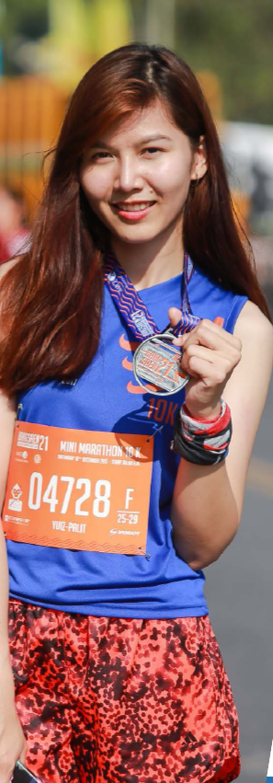
Bangsaen21-2018 13th – 16th December 2018
With increasing number of participants totaling over 13,080 runners in 2017, including 16 world elite runners from 5 countries and Thai elite runners joining the half marathon, the event follows a scenic route, with high safety standards, a world-class medical team and the latest innovation of racing technology.
The event’s success has led to a petition for it to be awarded the IAAF Road Race Bronze Label, expected in June 2018, one of only 101 certified events worldwide. The prestigious world standard is a first for a half marathon in Thailand and South East Asia.
Bangsaen21 has created a positive impact for the area promoting Bangsaen as a Sport Tourism City, with the readiness to host big events and welcome large numbers of participants, to its locations, hotels, accommodation, restaurants, shops and friendly locals.

Slide 5
Packages
BANGSAEN42-2018 & Bangsaen21-2018 have a comprehensive commercial sponsorship and partnership marketing programme with packages developed to suit differing levels of needs:
BANGSAEN42-2018
TIER 1 - Title & Presenting Sponsors
• One event Title Sponsor with naming rights to
BANGSAEN42-2018
• One event Presenting Sponsor to BANGSAEN42-2018
TIER 2 - Co-sponsors
• Up to six Official Co-sponsors from non-competing
categories
BANGSAEN42-2018
TIER 3 - Official Suppliers & Media Partners
• Up to 10 Official Suppliers providing goods & services
essential for BANGSAEN42-2018
• Up to 10 Official Media Partners for BANGSAEN42-2018
Bangsaen21-2018
TIER 1 - Title & Presenting Sponsors
• One event Title Sponsor with naming rights to
Bangsaen21-2018
• One event Presenting Sponsor to Bangsaen21-2018
TIER 2 - Co-sponsors
• Up to six Official Co-sponsors from non-competing
categories Bangsaen21-2018
TIER 3 - Official Suppliers & Media Partners
• Up to 10 Official Suppliers providing goods & services
essential for Bangsaen21-2018
• Up to 10 Official Media Partners for Bangsaen21-2018

Slide 6
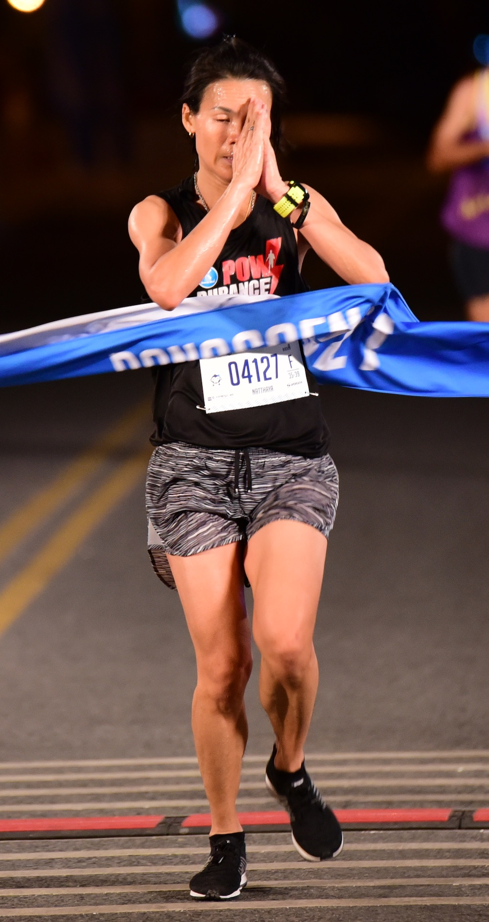
Why Get Involved?
Association with BANGSAEN42-2018 & Bangsaen21-2018 offers Sponsors numerous benefits including:
• Image Enhancement - with races set against spectacular scenery
• Brand Exposure - raising brand awareness of products and services and
association with healthy lifestyle
• Hospitality Opportunities - entertaining target audiences; internal and
external
• Integrated Marketing - worldwide media exposure
• Networking - with business leaders
Companies associating with BANGSAEN42-2018 & Bangsaen21-2018 tie in with the following values: Challenging; Diversity; Enjoyable; Exciting; Family Fun; Inclusivity; Major Event; and Professionalism.

Slide 11
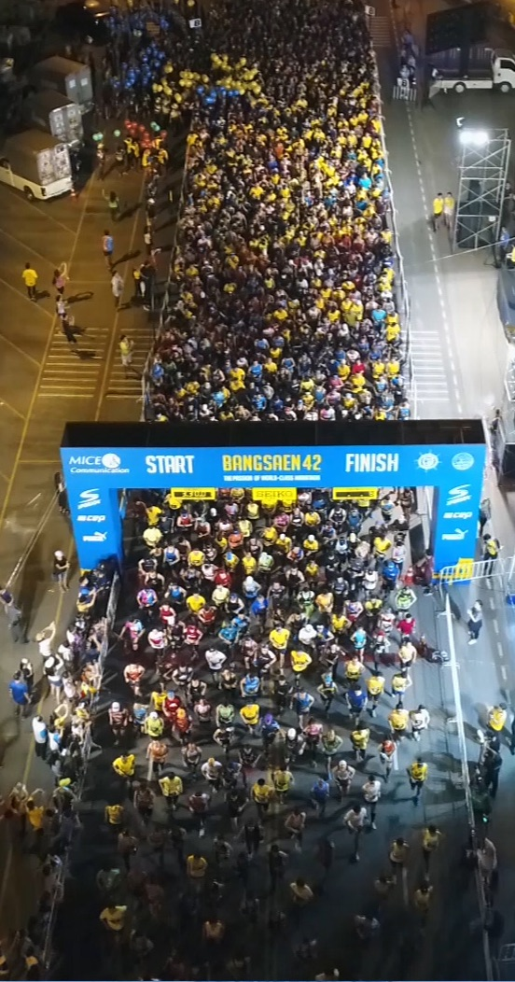
Branding
BANGSAEN42-2018 & Bangsaen21-2018 have many high-profile branding opportunities ensuring Sponsors have high visibility, before, during and after the event. These include:
Event Day Branding On Runners and at the Event
Expo Branding
Presence in PR Campaign and Promotional Materials both On and Off Line

Slide 12
Promotional Campaign
MEDIA PARTNERSHIPS
BANGSAEN42-2018 & Bangsaen21-2018 is seeking a maximum of 10 media partnerships.
PR SUPPORT
Sponsors and Partners can create media coverage through news PR activity. There will be coverage in local and national newspapers, Asian regional and international newspapers, TV, Radio and Magazines. Press releases will also be issued through a variety of regional and international running web sites.
All Sponsors and Partners will have rights to associate with BANGSAEN42-2018 & Bangsaen21-2018 for PR and advertising activity.
BANGSAEN42-2018 & Bangsaen21-2018 are supported by a comprehensive marketing campaign covering the following hooks:
Launch
Event Teasers
Online Registration Launch
Press Conference / Sponsor Announcement
Expo
Event Day

Slide 13
Digital & Social Programme
BANGSAEN42-2018 & Bangsaen21-2018 run a number of social media promotions throughout the year and is a great opportunity for Sponsors and Partners to integrate their brand message.
Facebook Page Followers
BANGSAEN42 Bangsaen21
13,500+ 55,900+
Digital Marketing
100,000 databases for Electronic Direct Mailers, e-Newsletter, Websites
Official Sites
https://www.BANGSAEN42.com
https://www.bangsaen21.com

Slide 14
EXPO
An Expo for both events will be held at the Bangsaen Heritage Ballroom, Bangsaen Heritage Hotel.
The Expo includes a number of activities and is an ideal platform for Sponsors to promote their products and services through trade booths and sampling activity.

Slide 15
Hospitality
BANGSAEN42-2018 & Bangsaen21-2018 offer a plethora of fantastic opportunities to entertain customers, clients and executives.
Sponsors will have a number of opportunities to entertain their guest through bespoke packages an excellent way to do and promote your business.

Slide 16
Merchandising
BANGSAEN42-2018 & Bangsaen21-2018 offer Sponsors and Partners the opportunity to produce joint branded merchandise.
This could be used as give-away through media and presence marketing promotions.
For example: BANGSAEN42-2018 & Bangsaen21-2018 Goodie Bags.

Slide 18
Organisers
BANGSAEN42-2018 & Bangsaen21-2018 are organised by MICE & Communications Co., Ltd. - a unique marketing and event company, based in Bangkok - winners of the SPIA ASIA: Thailand Best Sport Event organiser 2017.
With over 15 years’ experience MICE & Communications Co., Ltd. has organised events in all regions of Thailand and South-East Asia including Laos, Myanmar and Vietnam.
The company launched its first running event in 2015 with the Bangsaen21 Half Marathon. Since then it has won the award for “Best Half Marathon” running event in Thailand for three consecutive years. Other events include: KhaoKheow10; Run For Better City; Prachuap Khiri Run by Tipco; Thale-Noi Roi Run; Bangkok Women’s Run; RunARAN; SrirachaGP; and BANGSAEN42.
http://www.mice.co.th

Slide 19
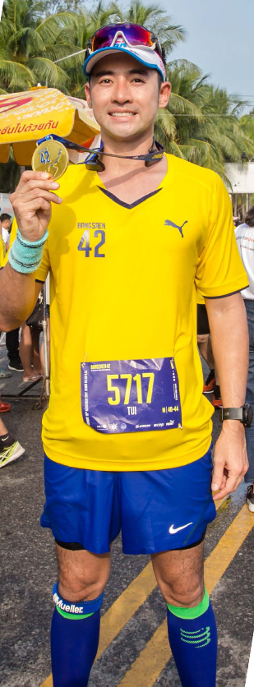
Contact
Paul Poole (South East Asia) Co., Ltd.
198 Tanou Road
Bovernives
Pranakorn
Bangkok 10200
Thailand
Tel./Fax: +66 2622 0605 - 7
www.paulpoole.co.th/bangsaen
Paul Poole - Managing Director
(English Speaking)
email: paul@paulpoole.co.th
Tel. +66 8 6563 3196
Udomporn Phanjindawan - Personal
Assistant (Thai/English Speaking)
email: udomporn@paulpoole.co.th
Tel. +66 8 6382 9949
MICE & Communication Co., Ltd.
138 Boonmitr Building, 3 Fl.
Room B5-B11
Silom Road
Suriyawong
Bangrak
Bangkok 10500
Tel: +66 2266 4465
Fax: +66 2266 4495
https://www.BANGSAEN42.com
https://www.bangsaen21.com
Napattrarut Tangtaveesub - Senior
Marketing Specialist (Thai/English Speaking)
email: napattrarut@mice.co.th
Tel: +66 8 2492 9818

