Slide 1
PRESENTATION TO:
BE PART OF THE 6TH ASIAN INDOOR AND MARTIAL ARTS GAMES – BECOME AN OFFICIAL SPONSOR / OFFICIAL SUPPLIER

Slide 2
6TH ASIAN INDOOR AND MARTIAL ARTS GAMES BANGKOK – CHONBURI 2021
17TH – 26TH NOVEMBER 2023
The 6th Asian Indoor and Martial Arts Games (AIMAG), one of the largest sporting events to take place in Thailand in recent years, will be held in Bangkok and Chonburi provinces between 17th – 26th November 2023.
Returning to Thailand for the third time, AIMAG is a Pan-Asian, multi-sport event held every 4-years. The 6th AIMAG Bangkok – Chonburi 2021 will boast 29 medal sports categories delivered to international standards, the highest number in the history of the games, including several new sports - badminton, BMX cycling, cheerleading, floorball, indoor rowing, netball, shooting and volleyball. The Games will also feature two demonstration sports – air sport and teqball.
Endorsed and organised by the Ministry of Tourism and Sports, Thailand, the Sports Authority of Thailand and the National Olympic Committee of Thailand under the auspices of the Olympic Council of Asia, the 6th AIMAG Bangkok – Chonburi 2021 is the second largest Asian multi-sport event after the Asian Games.
The hosting rights to the 6th AIMAG Bangkok – Chonburi 2021 were awarded to Thailand by the Olympic Council of Asia due to the country’s strong record in hosting professional sporting events. With a strong reputation for world-class hospitality and logistics, Bangkok, and neighbouring province Chonburi are well positioned to host a successful Games.
BE PART OF THE 6TH ASIAN INDOOR AND MARTIAL ARTS GAMES – BECOME AN OFFICIAL SPONSOR / OFFICIAL SUPPLIER

Slide 3
6th AIMAG Bangkok – Chonburi 2021 will reach millions through its huge footprint, which covers:
31 SPORTS
29 x MEDAL SPORTS
2 x DEMONSTRATION SPORTS
AIR SPORT – FPV Racing & TEQBALL
2 HOST CITIES
BANGKOK & CHONBURI
5,000 +
ATHLETES
GLOBAL TV AUDIENCE
WATCHED IN 45+ COUNTRIES ACROSS PLATFORMS INCLUDING: LIVE, DELAYED & DIGITAL
100,000+ SPECTATORS
EXPECTED ACROSS ALL SPORTS
MIILONS
OF FANS
45 COUNTRIES
REPRESENTED THROUGH NATIONAL OLYMPIC COMMITTEES
25 SPORTING VENUES
WITH CAPACITIES BETWEEN 100 – 3,500
290 GOLD MEDALS
TO BE WON ACROSS THE 31 SPORTS
16 SPORTS
PLAYED IN BANGKOK
15 SPORTS
PLAYED IN CHONBURI
1,000+
OFFICIALS
USD$ 48 MILLION
BUDGET TO BOOST THE LOCAL ECONOMY
114
WOMEN’S EVENTS
139
MEN’S EVENTS
37
MIXED EVENTS
10,000+
VOLUNTEERS
Originally due to take place from 21st to 30th May 2021, the event was postponed in January 2021 because of the COVID-19 pandemic.

Slide 4
COMMERCIAL PACKAGES
The Games Organising Committee (GOC) of the 6th Asian Indoor and Martial Arts Games Bangkok – Chonburi 2021 has developed a comprehensive commercial partnership marketing programme allowing business to integrate with this Pan-Asian event...
TIER 1 – OFFICIAL SPONSORS (MAIN SPONSORS)
Up to 6 x Official Sponsors will receive extensive advertising and promotional rights across the Games, broadcast, and all other platforms
TIER 2 - OFFICIAL SUPPLIERS (MAIN SUPPLIERS)
10 x Official Suppliers providing goods & services essential to the success of the games with distinctive association and promotional rights related the Games
OFFICIAL BROADCAST PARTNER
Packages for Broadcast Partners, covering: TV (live and delayed), live stream / digital coverage, as well as OTT services of the Games.
The Official Broadcaster Partner will cover: All Sports, Opening & Closing & Victory Ceremonies in Thailand, and all participating country territories.
Official Main Supplier categories include:
Airlines
Apparel
Automobiles
Banking
Beverages
Car Hire
Construction
Consulting
Consumer Electronics
Courier
Credit Cards
Engineering
Environment
Finance
Food
Hotels
Insurance
Legal
Logistics
Manufacturing
Not For Profit
Photography
Pharmaceuticals
Professional Services
Recruitment
Retail
Shipping
Technology
Telecommunications
Timing
Transport
Travel
Tyres
Utilities

Slide 5
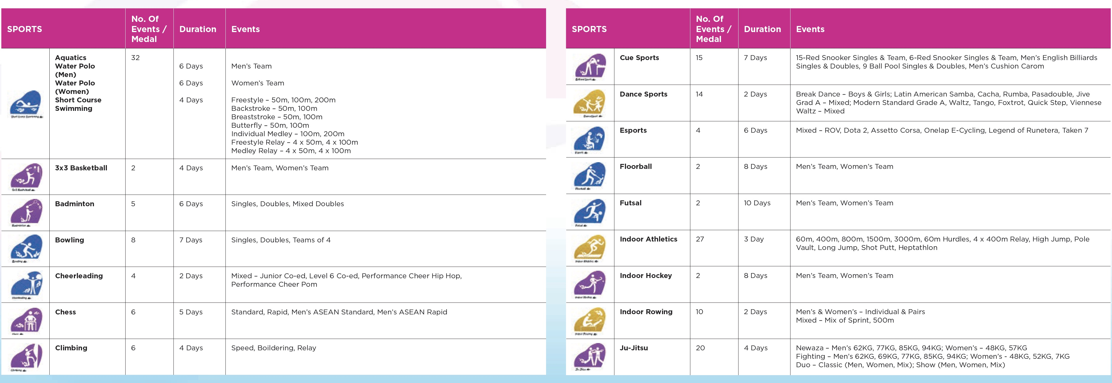
SPORTS

Slide 6
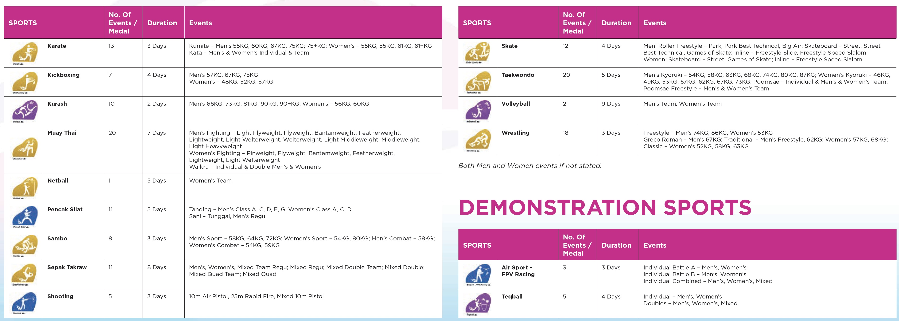
SPORTS

Slide 7
VENUES & CAPACITIES
BANGKOK & SURROUNDING VENUES
Sports events will take place at 13 venues in and around Bangkok for 14 sports and 2 demonstration sports…
CHONBURI VENUES
Sports events will take place at 7 venues in and around Chonburi for 15 sports…

Slide 8
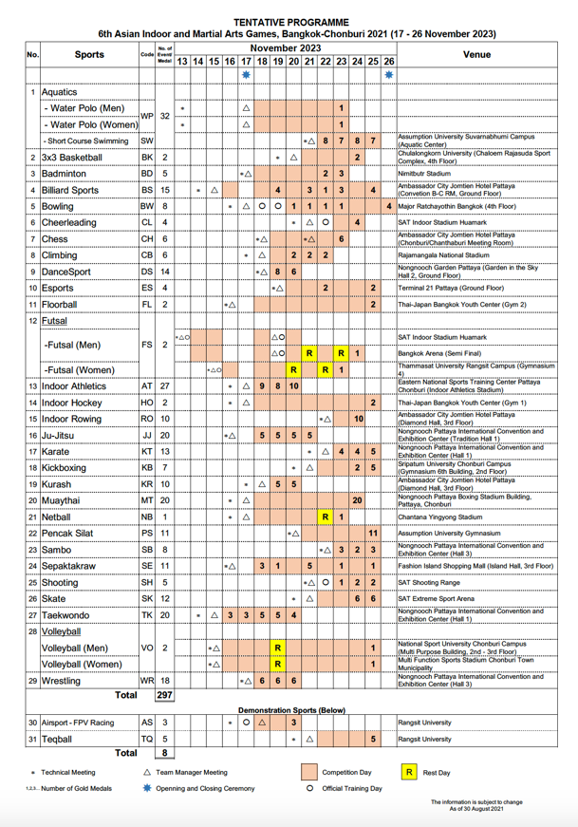
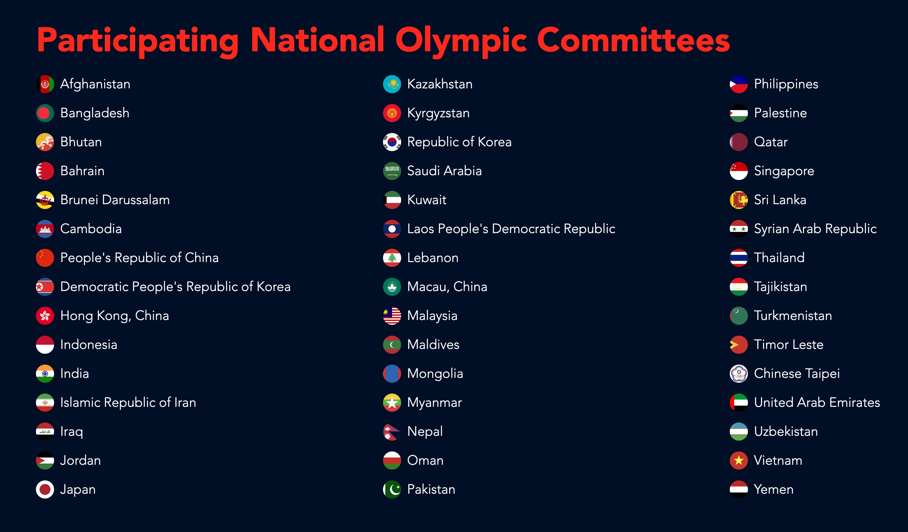
SCHEDULE
COUNTRIES REPRESENTED
PARTICIPATING NATIONAL OLYMPIC COMMITTEES
45 x National Olympic Committees that make up the Olympic Council of Asia (OCA)
Information updated on 31 August 2021

Slide 9
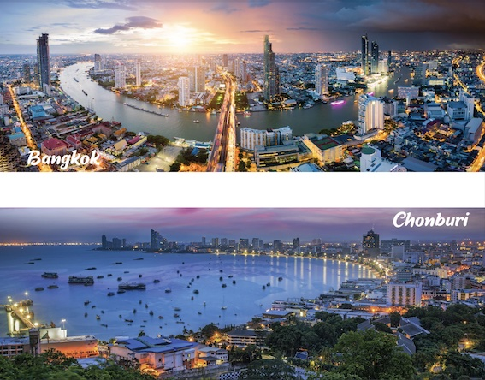
ABOUT THE GAMES
This will be the first Asian Indoor and Martial Arts Games, co-hosted by two cities / provinces: the Thai capital city of Bangkok, which will host the Games for the third time after hosting the inaugural edition in 2005 and the martial arts edition in 2009; and the province of Chonburi, located 100km southwest of the capital.
It will be a test event for the joint candidacy from Bangkok and Chonburi Province for hosting 2030 Summer Youth Olympic Games.
In its current format, there has been two previous Asian Indoor and Martial Arts Games…
Year Host Nations Competitors
2013 Incheon, South Korea 43 1,652
2017 Ashgabat, Turkmenistan 63 4,012
Before this, the Asian Indoor Games ran in 2005, 2007 and 2009 and the Asian Martial Arts Games in 2009. The Asian Indoor Games merged with Asian Martial Arts Games in 2013.
GAMES MISSION & VISION
Thailand has been honoured to host many international sporting events due to its readiness in all areas of competition management and operation. Thailand’s traditional culture exudes warmth of hospitality, care and service in sports and tourism.
In 2005 Thailand was honoured by the OCA to host the 1st Asian Indoor Games. In 2009, Thailand was honoured again by the OCA to host the 1st Asian Martial Arts Games and now in 2023 Thailand once again honoured to host the 6th Asian Indoor and Martial Arts Games.

Slide 10
ABOUT THE GAMES
EMBLEM & MOTTO
The Official Emblem of the 6th Asian Indoor and Martial Arts Games Bangkok – Chonburi 2021 is inspired by the flower garland called Phuang Malai, symbolising the interconnectedness of all participants from all parts of Asia. The Thai garland represents respect, victory, dignity, and the power of hope.
The Official Slogan of the Games is "Garland of Hope".
MASCOTS
The Official Mascot depicting a fighting parrot wearing a mongkhon (a type of headgear worn by Muay Thai athletes) who has intelligence, agility, and a fighting spirit, making a gesture of inviting athletes and sports competitors to the victory of friendship.
PICTOGRAMS
Each of the 31 sports has a specifically designed pictogram depicting that sport…

Slide 11
ABOUT THE GAMES
OPENING & CLOSING CEREMONIES
Opening Ceremony
The much-anticipated Opening Ceremony will take place on Friday 17th November 2023 in Bangkok and will include a pre-show and main event.
Closing Ceremony
The Closing Ceremony will take place on Sunday 26th November 2023 in Bangkok.
VICTORY CEREMONIES
Where possible all winning athletes will be presented with their medals immediately after the completion of the event by either the President of the OCA or other members as delegated by the President of the OCA (or his representative), accompanied by the President of the Asian Sports Federation concerned.
The Opening & Closing Ceremonies will be broadcast live to over 45 countries and a stadium audience of over 3,000 spectators in Bangkok.
CULTURAL PROGRAMME
The 6th Asian Indoor and Martial Arts Games Bangkok – Chonburi 2021 is supported by a Cultural Programme of exhibitions covering architecture, painting, sculpture, music and others. All Sponsors & Suppliers will have the opportunity to attend these events as part of their association. The Cultural Programme is currently being finalised.
SPONSORS VILLAGE
The Games will feature a Sponsors Village with display areas for all Sponsors & Suppliers to promote and sell their products and services.
HOSPITALITY VILLAGE
The Games will feature a Hospitality Village for Sponsors & Suppliers, Broadcasters, and the Media to meet.
ATHLETE’S HOTELS
Home to over 5,000 participating athletes from 45 countries.
GAMES SOUVENIRS
Sponsors & Suppliers will have access to Official Games Souvenirs, including replica medals, flags, licenced products, decorations, posters, pins, badges, mascots and any other souvenir type items.

Slide 12
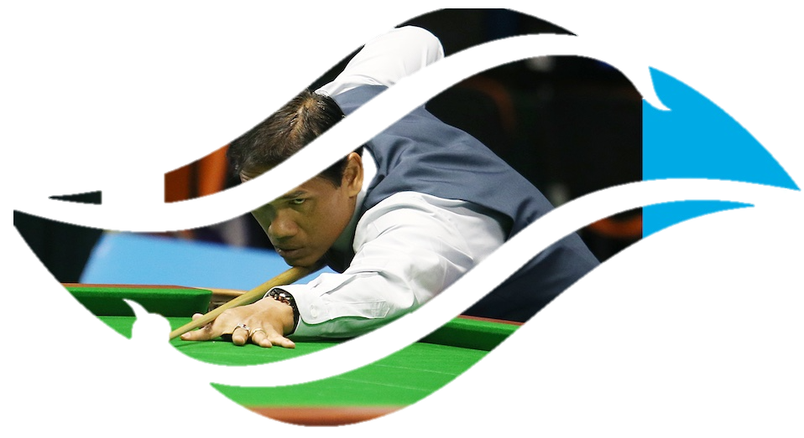
WHY GET INVOLVED?
6th Asian Indoor and Martial Arts Games Bangkok - Chonburi 2021 will be extensively broadcast via live, delayed, digital and OTT as well as publicised through a varied and diverse mix of marketing methods and print and online outlets.
A Sponsor and / or Supplier’s participation in 6th Asian Indoor and Martial Arts Games Bangkok - Chonburi 2021 not only strengthens awareness of its brand, products, and services to an audience of important decision-makers but also confirms its position as an industry leader.
HOW THE GAMES CAN HELP YOUR BUSINESS
Association with 6th Asian Indoor and Martial Arts Games Bangkok – Chonburi 2021 offers Official Sponsors & Official Suppliers numerous benefits including:
YOUR BRAND - be associated with one of Asia’s largest multi-sport events, attracting thousands of athletes from 45 countries in Asia and engage with thousands of fans.
YOUR VALUES - the Games is inspired by the flower garland called Phuang malai, symbolising the interconnectedness of all participants from all parts of Asia. The Thai garland represents respect, victory, dignity, and the power of hope.
YOUR AMBASSADORS - follow athlete’s journeys, engage your staff, clients and customers with their story and the story of the Games.
YOUR CLIENTS AND CUSTOMERS - entertain at bespoke events including Opening & Closing Ceremonies, inspire with iconic athletes, and engage with competitions and VVIP & VIP sports tickets.
YOUR SALES - tap into the 31 sports, the Games’ commercial family and network of contacts can help enhance your sales and B2B development through its promotional programme and Sponsors Village.
YOUR STAFF - inspire with athletes and performance coaches, advice and leadership training, reward with ticketing, involve through volunteering.
YOUR REPUTATION – the Games provides the ideal platform for marketing activity. The Official Mascot depicts a fighting parrot wearing a mongkhon (a type of headgear worn by Muay Thai athletes) who has intelligence, agility, and a fighting spirit, making a gesture of inviting athletes and sports competitors to the victory of friendship.

Slide 13
WHY GET INVOLVED?
BRAND EXPOSURE
BROADCAST EXPOSURE
In camera signage advertising with Sponsor & Supplier logos clearly visible at all Games Venues, where appropriate.
Opportunities for product placement and advertising packages as part of 6th AIMAG Bangkok – Chonburi 2021 broadcast, online & OTT programme, which is currently being finalised.
Broadcast coverage, to include: Live and delayed coverage of sports; Opening & Closing Ceremonies; Medal Presentations; Daily News & Highlights; Pre-event Build-up Programmes; Post-event Summary Highlights.
Dedicated social and digital media platforms with live streaming.
Details to be confirmed by end of 2021.
The opportunity to integrate with 6th AIMAG Bangkok – Chonburi 2021.
GAMES BRANDING
SIGNAGE AT ALL SPORTS & NON-SPORTS VENUES INCLUDING OPENING & CLOSING CEREMONIES, MEDAL PRESENTATIONS
MEDIA CENTRES
AT INTERNATIONAL
BROADCAST CENTRE, MAIN PRESS CENTRE, PRESS CONFERENCES & PRESS INTERVIEW BACKDROPS
ATHLETES / OFFICIALS / VOLUNTEERS
LOGO ON ATHELTE BIBS & OFFICIAL & VOLUNTEER UNIFORMS
ATHLETES’ HOTELS
HOME TO 5,000+ ATHLETES, COACHES AND OFFICIALS
SPONSORS VILLAGE
DISPLAY AREA TO PROMOTE & SELL PRODUCTS & SERVICES
GAMES PROMOTIONAL CAMPAIGN
WORKSHOP / SEMINAR BRANDING
HOSPITALITY VILLAGE
FOR ALL SPONSORS, SUPPLIERS, BROADCASTERS AND MEDIA
TICKET BRANDING
LOGO ON REVERSE OF TICKETS
Branding displayed at all Games venues, including: Sports Venues; Airports; Official Hotels; Athletes Hotels; Hospitality Village; Sponsors Village; prominent places throughout Bangkok and Chonburi as part of the Games Promotional Campaign; as well as all other Games related sites.

Slide 14
WHY GET INVOLVED?
PROMOTION & PR RIGHTS
GAMES PROMOTIONAL CAMPAIGN
6th AIMAG Bangkok – Chonburi 2021 will be supported by an all-encompassing promotional campaign running in the build-up to the Games, during the Games and post Games. It covers:
PR & CONTENT
The PR campaign ensures wide coverage both during and after the Games and will feature:
Features on the Games
Online campaign of advertising, editorial, blogging and social media
International and local news channels
ADVERTISING
A paid-for media campaign will include the creation of at least three (3) different creative themes, as directed solely by the OCA, with executions in the television, print, radio and internet media. The campaign will be executed to achieve the maximum regional and national impact in the lead up to the Games.
ONLINE - 6th AIMAG Bangkok – Chonburi 2021 marketing team will work closely with leading international industry web portals to reach subscribers and visitors through web advertising and targeted email campaigns.
ALL MEDIA - a media-wide (TV, RADIO, PRINT & ONLINE) advertising campaign will run in the build-up to the Games, during the Games and post Games. Currently being developed.
OUTDOOR - The Games will be supported by an outdoor poster campaign. Details currently being finalised.
OFFICIAL PROGRAMMES
Sponsors & Suppliers will be included in the Official Games Programme – available in hard copy and online.
YOUR OWN CAMPAIGN
As well as the Games PR campaign, all Sponsors & Suppliers will have rights to create their own PR and Advertising campaigns and associate with the 6th AIMAG Bangkok – Chonburi 2021 through this PR and advertising activity.
Sponsors & Suppliers can create content through, for example: Q&As with Athletes / Officials; Fun Challenges; Celebrity and Expert Speaker Features; Sponsor Village Highlights; Onsite Promotions; Press Conferences; and Charity Links.

Slide 15
WHY GET INVOLVED?
ATHLETE ACCESS RIGHTS
DIGITAL & SOCIAL RIGHTS
Sponsors & Suppliers will have access to athletes, coaches and officials. This association can be used to develop exclusive content for Games exploitation campaigns, including for example:
Content for Digital Outreach - using athlete and coaches as ‘incredible’ stories and inspirational role models
Motivational Speaking - what better to inspire your staff or engage your customers than appearances from medal winning athletes and / or inspirational coaches. Behind every medal-winning athlete is a team of experts, performance staff and sports specialists creating the perfect high-performance environment. The overlap between high performance sport and business has been seen time and again. Our partners can access these industry leaders for appearances, training materials or webinars for staff motivation, goal setting and improved performance.
Branding and availability of products / services in the Athlete’s Hotels.
The Games and its many social channels allow Sponsors & Suppliers to follow and integrate with the journey digitally, create exclusive engaging content and benefit from the social reach of athletes and participating National Sports Federations, as well as the Olympic Council of Asia and the Sports Authority of Thailand.
Here are some examples of the vast reach of the Games…
TWITTER – https://twitter..com/AsianGamesOCA/ - 42.7K Followers
FACEBOOK – https://www.facebook.com/AsianGamesOCA/ - 187K Followers
INSTAGRAM – https://www.Instagram.com/AsianGamesOCA/ - 246K Followers
YOUTUBE – https://www.youtube.com/user/ocasianumber1 - 3.14K Subscribers
WEB – www.aimag2021.com
COMMUNITY & SOCIAL RESPONSIBILITY RIGHTS
An association with 6th Asian Indoor and Martial Arts Games Bangkok - Chonburi 2021 offers a platform to promote diversity and inclusion and other CSR activity.
The Games supports: women in sport, socially disadvantaged communities, anti-obesity programmes, disabled athletes, young athletes, minor sports and non-funded athletes.
Sponsors & Suppliers will have access to:
Athlete Ambassadors
The volunteer programme so their employees can get involved
A series of visits from AIMAG ambassadors to schools
Use expert coaches, nutritionists and athletes to inspire health and wellness in the workplace

Slide 16
WHY GET INVOLVED?
HOSPITALITY & NETWORKING RIGHTS
SPONSOR VILLAGE
HOSPITALITY VILLAGE
The Games has a conveniently located sponsor Hospitality Village, available for all Sponsors, Suppliers, Broadcasters and Media to network and entertain their customers, clients, suppliers, staff and other audiences.
GAMES MARKETING CLUB
Within the Hospitality Village there will be a Games Marketing Club for Sponsors & Suppliers to meet.
EVENTS & TICKETS
Sponsors & Suppliers are invited free of charge to any official functions, receptions and other events and occasions hosted by AIMAG in connection with the Games.
Sponsors & Suppliers will be allocated tickets to sports events as well as all official events and functions including the Opening & Closing Ceremonies.
These cover VVIP and VIP tickets and where relevant accommodation, accreditation and parking.
AIMAG has created a special SPONSORS VILLAGE where all Sponsors & Suppliers can display, promote and sell products and services.
MERCHANDISING RIGHTS
We offer our Sponsors & Suppliers the opportunity to produce joint branded merchandise. This could be used as give-aways through media and presence marketing promotions. For example, t-shirts, caps, watches, sunglasses etc.
No merchandising of any description is allowed at the Games without approval of AIMAG.
MANAGEMENT & REPORTING RIGHTS
Partner Workshop: Sponsors & Suppliers are invited to attend at least two Partner Workshops prior to the Games, to network and share ideas on how to exploit their involvement with the Games.
Post-Games Report: AIMAG provide an evaluation report relating to the Games activities of the Sponsors & Suppliers.
EXPERIENTIAL RIGHTS
As well as spectators to the sports events, Bangkok and Chonburi attracts hundreds of thousands of visitors in November and with it huge opportunities for Sponsors & Suppliers to promote their products and services.

Slide 17
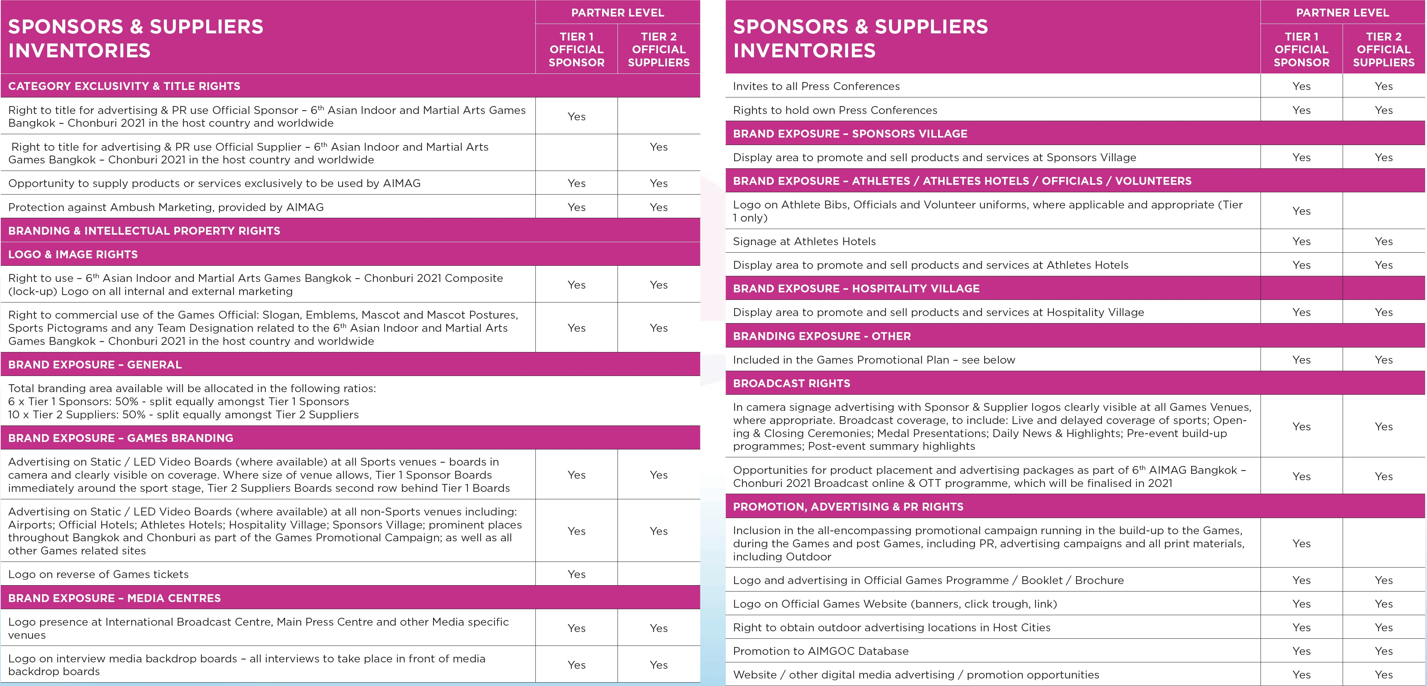

Slide 18
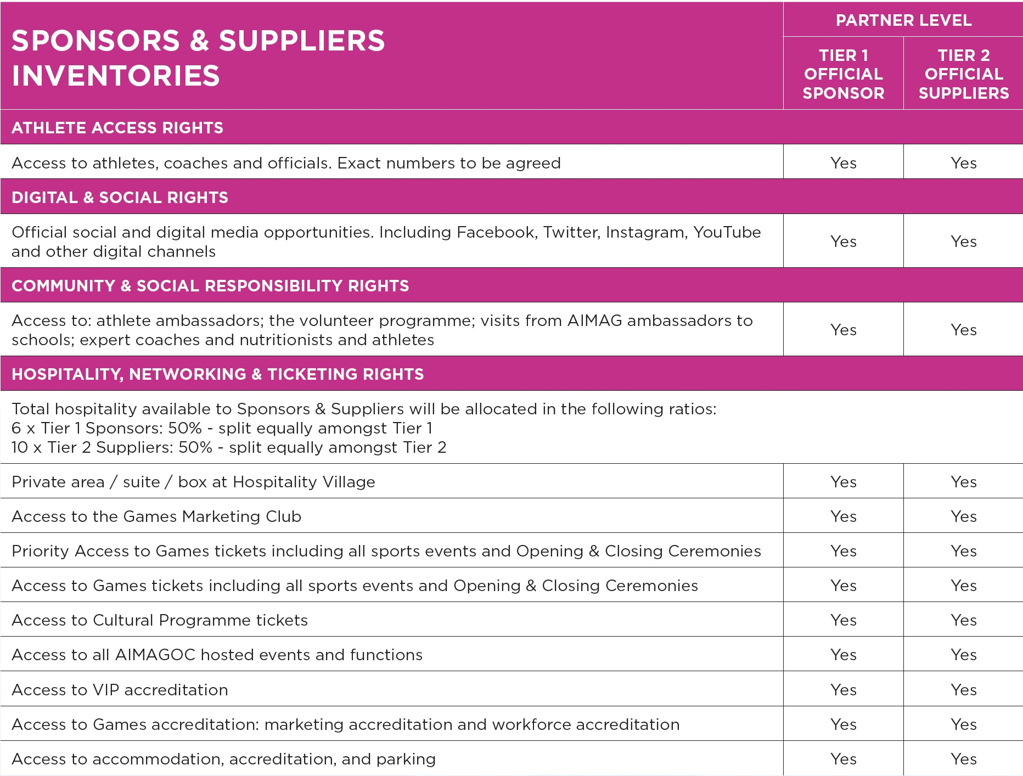
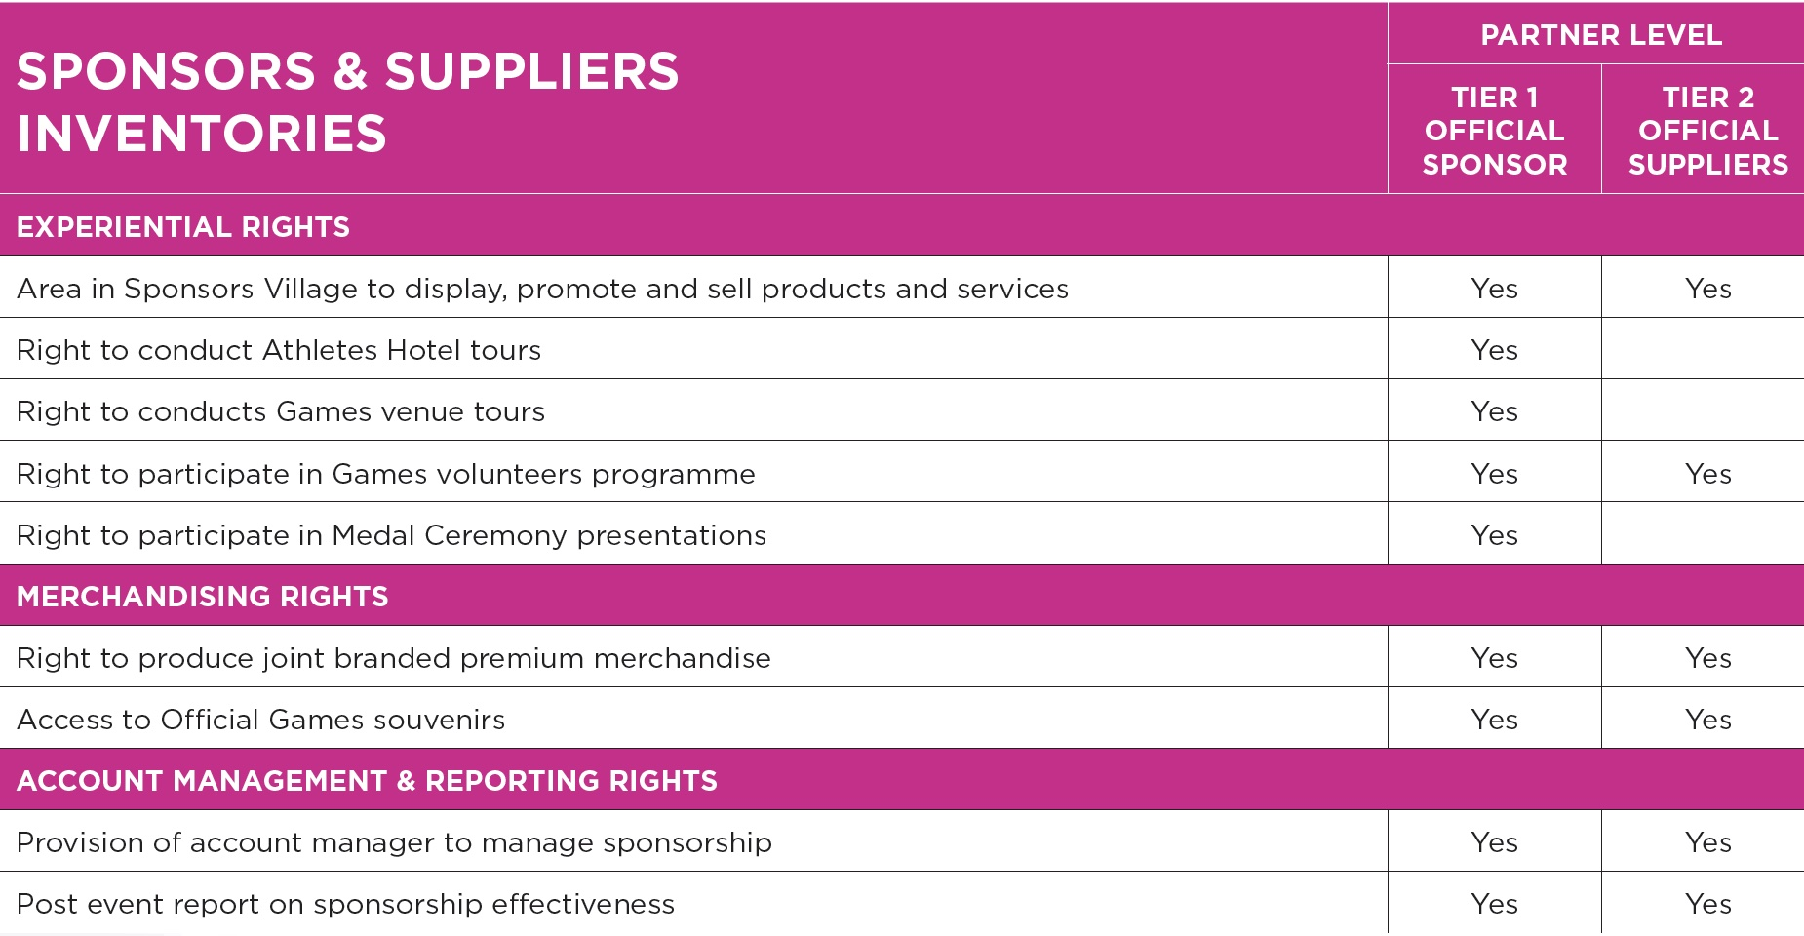

Slide 19
ORGANISING COMMITTEE
CONTACT
The Organising Committee to deliver the Games comprises the Sports Authority of Thailand, Ministry of Tourism and Sports (Thailand), the Thailand National Olympic Committee, of Thailand, Royal Thai Police, Ministry of Health under the auspices of the Olympic Council of Asia.
EXCLUSIVE COMMERCIAL AGENCY
The Sports Authority of Thailand (SAT) has signed a full-service agreement with The Sponsorship Experts / Paul Poole (South East Asia) Co., Ltd. for the 6th Asian Indoor and Martial Arts Games Bangkok - Chonburi 2021. The Sponsorship Experts are providing full service commercial sponsorship and partnership marketing support.
PAUL POOLE (SOUTH EAST ASIA) CO., LTD.
198 Tanou Road
Bovernives
Pranakorn
Bangkok 10200
Thailand
Tel./Fax: +66 2622 0605 - 7
www.paulpoole.co.th/6aimag
PAUL POOLE - MANAGING DIRECTOR (ENGLISH SPEAKING)
Email: paul@paulpoole.co.th
Tel. +66 8 6563 3196
UDOMPORN PHANJINDAWAN - PERSONAL ASSISTANT (THAI/ENGLISH SPEAKING)
Email: udomporn@paulpoole.co.th
Tel. +66 8 6382 9949
SPORTS AUTHORITY OF THAILAND
286 Ramkhamhaeng Road,
Hua-mak, Bangkapi
Bangkok, 10240
Thailand
Tel. +66 2186 7111
Fax: + 66 2186 7509
www.aimag2021.com
DOME PHUMIDIT – DIRECTOR OF SPORTS BUSINESS DEPARTMENT (THAI SPEAKING)
email: dome@sat.or.th
Tel. +66 8 1991 4991

